Slide 1
Network models
(Modeling of the decision processes)

Slide 2
Analysis of the flows in network
Developed for analysis of transport networks (railway, road, pipelines …)
Definition:
Flow in edge f_{ij} – transported amount through the edge
Capacity of the edge k_{ij} – max. amount, which can be transported through the edge

Slide 3
Analysis of flows in networks - definition
Total flow in network F – amount, which can be transported through the network between the places of the choice, which complies to following conditions:
For each node k=2,3…n-1 must apply, that amount entering and leaving node equals

Slide 4
Total flow F conditions
In first node the flow F enters the network
In last node (n^{th}) the flow F leaves the network
The flow in edges must not exceed its capacities
f_{ij} ≤ k_{ij}

Slide 5
The problems solvable by this approach
Finding the path with largest capacity
Finding the path with lowest capacity
Evaluation of overall capacity of the network
Finding new (optimal) graph connecting separate nodes

Slide 6
Network capacity
We are interested in max. possible capacity of the network between nodes A and B
Usage of relatively undemanding marking algorithms
We are choosing possible path between nodes A and B, capacity of the path is determined by lowest capacity on the path

Slide 7
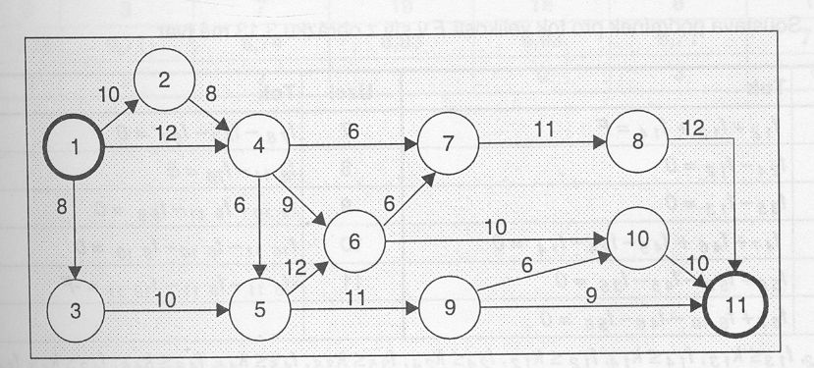
Pipeline network

Slide 8
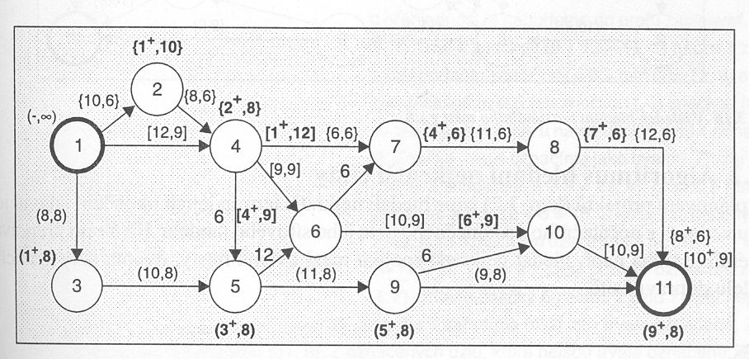
Marked network

Slide 9
Shortest path
Modified marking algorithm
Very similar to CPM method in project network
Searching for path which is physicaly shortest

Slide 10
Dijkstra’s algorithm – searching for shortest path
Create list of distances, list of visited nodes, list, list of past nodes and list of present nodes
All values in distance list are set to ∞, only first node is set to 0
All values in list of visited nodes is set to FALSE
All values in list of past nodes are set to undef.

Slide 11
Dijkstra’s algorithm – searching for shortest path
List of present nodes is set in the same way as first node
Set present node as visited
Update distance list and list of past nodes based on nodes, which are directly reachable from actual node
Updace actual node in list of unvisited nodes, which may be reached using shortest path from first node
Repeat from step 6 until all nodes are visited

Slide 12
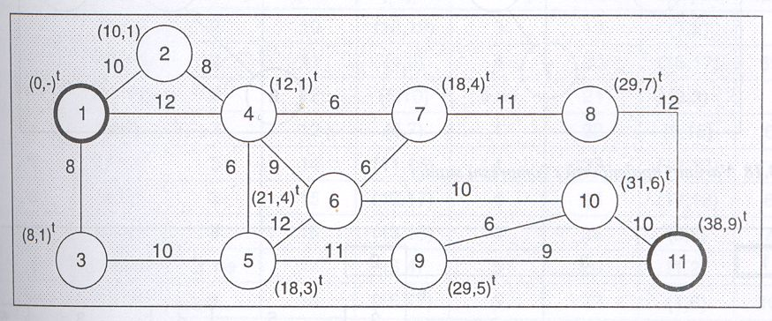
Shortest path graphicaly

Slide 13
Ford-Fulkerson’s algorithm for path with max. capacity
IN: graf G with known capacities of the flows c, first node s and final node t
OUT: flow f from node s to t, which is maximal
F(u,v) ← 0 for all edges (u,v)
Until there is path p from s to t such, that c_{f}(u,v) > 0, for all edges (u,v) ∈ p:
  find c_{f}(p) = min{c_{f}(u,v)|(u,v)∈p}
  for all edges (u,v)∈p
    f(u,v)←f(u,v)+c_{f}(p) :(send flow on its way)
    f(u,v)←f(u,v)-c_{f}(p) :(the flow may be send back later)

Slide 14
Graph of the type tree
Acyclic graphs with 1 initial and many final nodes
Problem: find the tree such, that it connects all nodes by edges with lowest possible costs
Solving using Kruskal’s algorithm

Slide 15
Kruskal’s algorithm
All possible connections between nodes are evaluated (in unit of choice)
Order list of connections using criterion of choice (descending from the best to the worst)
Create tree: we add the edges following our list
Check the new edge – if its adding created cycle in graph, throw it away and use next connection in list
Do until all nodes part of the graph

Slide 16
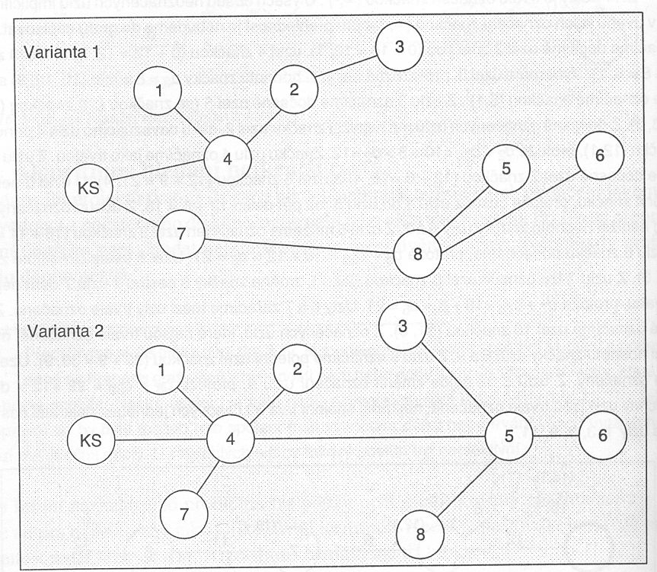
Graph of the type tree

Slide 17
Network models and critical infrastructure
Most of critical infrastructure has character of network
  pipelines
  Road/railway network
  Internet
  Telecomunication network in general
  Electric grid
  Sewerage network
  …

Slide 18
Problem
How can we evaluate properties of such networks (safely)?
Measurement, modeling of behavior, considerations on function of real-world networks
Experimenting with artificial models of network, which have same statistical properties as real-world networks
Combination of both

Slide 19
Consideration
Networks of critical infrastructure show high amount of organization
The significance of the node is derived usually from the number of edges connecting in to network
From properties we usually distinguish scale-free networks and small world networks.

Slide 20
Emergence effect
How became the real world networks so organized?
Answer: emergence effect
Possible function of emergence effect has been described in 1994 by Mitchell Resnick on example of termites and its behavior

Slide 21
Termites
Termites in simulation follow simple rules
  Termite moves randomly
  If termite finds the stone, it will take it
  If termite finds another stone, it will release the one it is holding
  Termite moves randomly (the cycle continues)
(simulation)

Slide 22
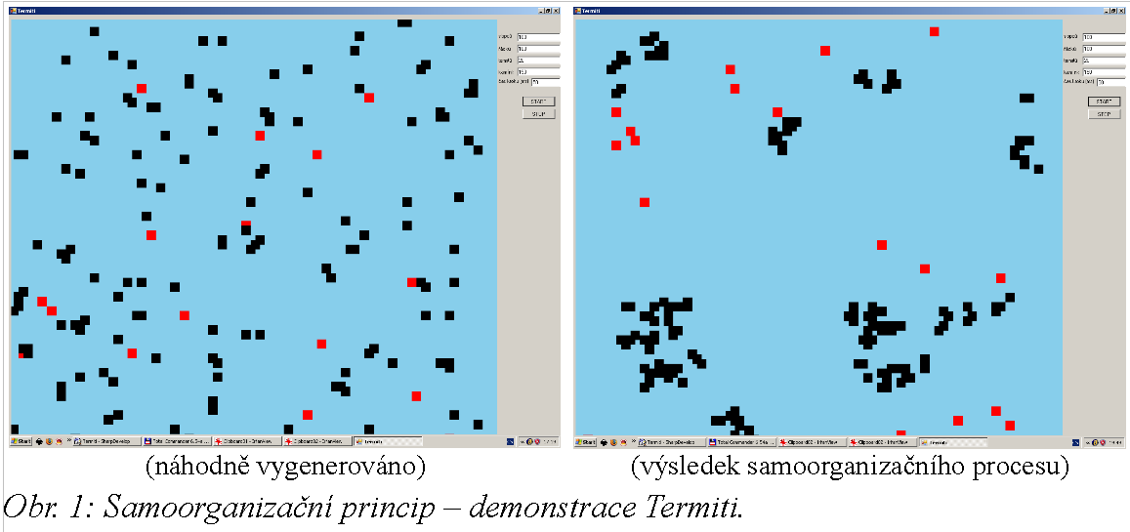
Chaos vs. emergence

Slide 23
Emergence effect and critical infrastructure
Principle of repeated investment
Example: the more people has Internet, the more people wants it
Example: the more people has MS Office, the more people needs it to be compatible
Critical infrastructure: the more edges lead to node, the higher probability next one wil lead to it

Slide 24
Principle
Randomly choose edge
Randomly choose another node
Replace original edge by new one between nodes with highest amount of edges leading to it
(simulation)

Slide 25
Small world
Again emergence effect, but different principle
Prefered connection between closest nodes
(simulation)

Slide 26
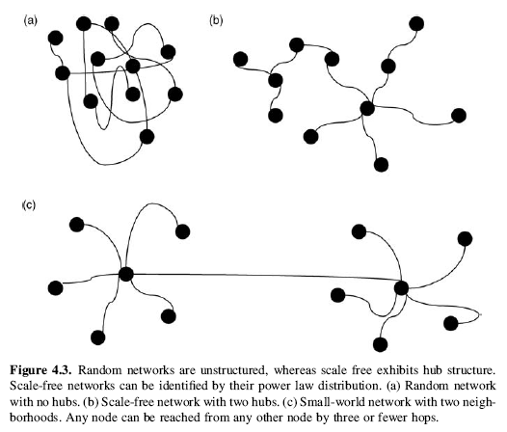
Comparation of network types

Slide 27
Usability
Modeling of
  Network behavior
  Cascade failure of network
  Electivity of protective measures

