Slide 1
Localization models
(modeling of decision processes)

Slide 2
Localization models
Solve problems with allocation, optimization of transportation road system etc.
Division from point of view of the number of localized objects
  Localization of one object
  Multiple object localization
From point of view of available space
  unlimited
  discrete

Slide 3
Model categorization
No. of objects to localize
  Stated (part of the task definition)
  Should be optimized too – we usually try to find minimal necessary number of objects required to solve the task
Objects
  are
  Or are not in interaction with each other
Localization
  2D
  3D

Slide 4
Example
We need to localize the single storage unit for four existing manufactures producing necessary parts
Manufacture | Coordinates |  | Req. no. of goods
A | 1 | 2 | 400
B | 2 | 7 | 400
C | 4 | 3 | 200
D | 6 | 5 | 300

Slide 5
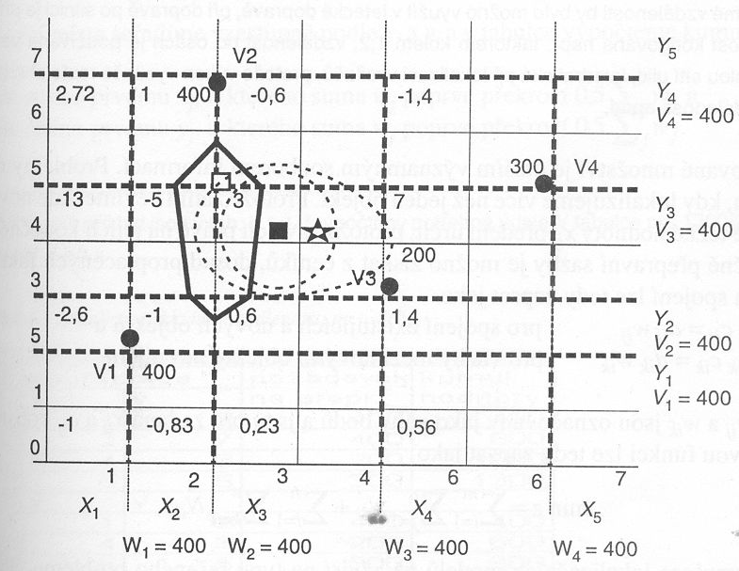
Example graphically
Direct (line) distance
Axial distance
Quadratic distance

Slide 6
Optimization problem
Optimizing the costs N_{ij} as in connection with newly localized objects with n existing ones
Costs
  Function of transportation distance d_{ij}
  Amount of transported (goods) x_{ij}
  Type of transport vehicle with different transportation costs c_{ij}

Slide 7
Distance
Line (direct)
Line with correction
„using axis“
quadratic

Slide 8
Costs
Connection of existing and new objects
N_{ij}=x_{ij} d_{ij} c_{ij} = d_{ij} w_{ij}
Connection between new objects
N_{ik}=x_{ik} d_{ik} c_{ik} = d_{ik} w_{ik}
Values w_{ij} and w_{ik} are described as weights of points and are constants for stated x_{ij} and c_{ij}.
Cost function may be expressed in following way:

Slide 9
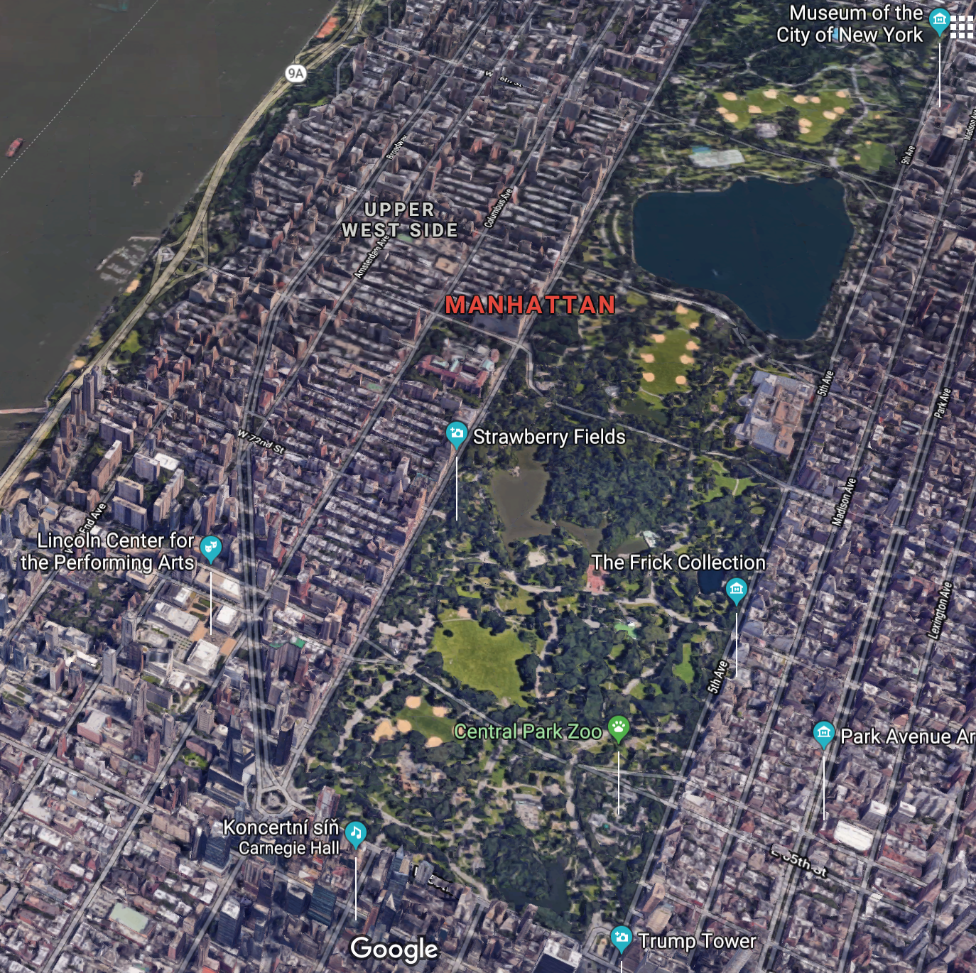
Localization of the object in 2D using axial distance
Minimizing the objective function
It is possible to divide objective function into parts
Search for values x and y must be equal to some x_{j} and y_{j}
Not more then half x_{j} must be left from x and similarly for y

Slide 10
Solution
For X coordinate
  We order existing places ascending by x_{j} and compute values of w_{j}
  X will be equal to first x_{j} for witch sum of w_{j} exceeds value sum(w_{j})/2
Similarly we get coordinate y
  We order existing places ascending by y_{j} and compute values of w_{j}
  X will be equal to first y_{j} for witch sum of w_{j} exceeds value sum(w_{j})/2

Slide 11
Axial distance – solution of our task
coordinates |  | Req. for transport | Cumulated values
X (order by) | Y
1 | 2 | 400 | 400
2 | 7 | 400 | 800
4 | 3 | 200 | 1000
6 | 5 | 300 | 1300
X | Y (order by)
1 | 2 | 400 | 400
4 | 3 | 200 | 600
6 | 5 | 300 | 900
2 | 7 | 400 | 1300
Storage building should be localized at coordinates 2, 5 (X, Y)

Slide 12
Localization of one object in 2D (quadratic distance)
Objective function
Coordinates are gained by derivation of this function and putting it equal to 0
Fortunately analytic solution exists

Slide 13
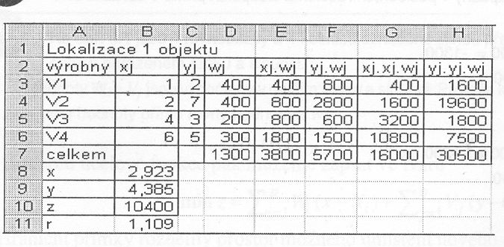
Solution – quadratic distance
Localization of one object
manufactures
sum

Slide 14
Localization models - line
Widely used
Objective function
For k = 1, we will search for minimum of function
Unfortunately analytic solution does not exist
Usage of numeric methods required

Slide 15
Solution of the model
After small formal change
We need to iterate to find optimal solution for this problem

Slide 16
How to do that?
Lets choose appropriate support function
Where ε is close to 0,
inclusion is necessary, because theoretically x and y could be equal to x_{j} and y_{j} and we would divide by 0
Expression for searched for coordinates could be written:

Slide 17
Solution
As starting point we use optimal point of quadratic distance (its easy to compute and relatively close to optimal solution)
We choose small ε close to 0
Choose step of objective function, we will consider as not significant Δz_{min} (otherwise we would compute forever)
In k-iteration we will find new coordinates

Slide 18
Solution – iterating through the coordinates
First set of coordinates x⁽¹⁾, y⁽¹⁾ = quadratic distance coordinates
From coordinates x^{(k)}, y^{(k)} we will go to next set of the coordinates x^{(k+1)}, y^{(k+1)}
We compute Δz = z^{(k)}-z^{(k+1)}. If Δz < Δz_{min} then the coordinates can be considered as optimal.

Slide 19
Localization of multiple objects in 2D – axis distance
We state objective function respecting the connection between new objects
We can divide into two functions

Slide 20
Localization - solution
We can solve as problem of linear programming, but we have to deal with absolute values, so for each
  x_{i}x_{j} and y_{i}y_{j} positive numbers c_{ij} a d_{ij}
  x_{i}x_{k} and y_{i}y_{k} positive numbers c’_{ik} a d’_{ik}
Constrained by
  c_{ij},d_{ij} ,c’_{ik}d’_{ik} ≥ 0
  c_{ij}d_{ij}=0 and c’_{ik}d’_{ik}=0
  x_{i} – x_{j} – c_{ij} + d_{ij}= 0
  x_{i} – x_{k} – c’_{ik} + d’_{ik} = 0

Slide 21
Solution

Slide 22
Solution
It is possible to solve by simplex method if we do not take into account non-linear constrains

Slide 23
Localization of multiple objects in 2D – quadratic distance

