Slide 1
Methods for decision support
Brainstorming
Mind Maps
Delphi method
Analysis of Sensitivity
(Modelling of Decision Processes)
Doc. Ing. Pavel Šenovský, Ph.D.

Slide 2
Brainstorming and minmap
Related methods
Similar approach to the problem, but different philosophy of usage
These methods do not solve decision situation
Methods allow for easier orientation in the decision situation
Usable as a base to choose other methods for solution
Used mostly at the beginning of the process

Slide 3
Brainstorming
team method
traditionally uses chalk and blackboard
team leader specifies theme in the middle of the blackboard
team members voice their ideas and leader writes them down and notes connections between them
usage
management
economic forecasting
when searching for the way to continue ...

Slide 4
Brainstorming rules
only one person speaks
ideas are only written down, nobody comments them, nobody evaluates them
support for relaxed working atmosphere – motivates the team to voice even “stupid” ideas, which may surprisingly prove their value in future
everything is written down, without exceptions

Slide 5
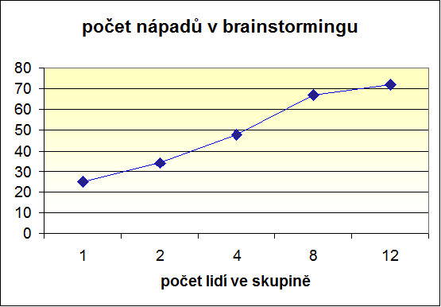
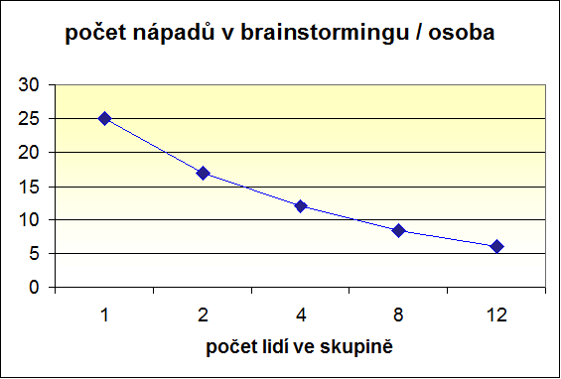
Brainstorming – number of ideas
No. of ideas in brainstorming
No. of ideas in brainstorming/person
No. Of people on group
No. Of people on group

Slide 6
Mind maps
Usually with usage of the computers – it is possible to use pen and paper but only for limited purposes
more individual method – usually not used in the larger team meetings (unlike brainstorming)
it is possible to use the software as replacement for blackboard in brainstorming – but is not used usually that way
main goal of the usage is to gather and organize knowledge, ideas in certain area
result is the mind map

Slide 7
Mind map - example

Slide 8
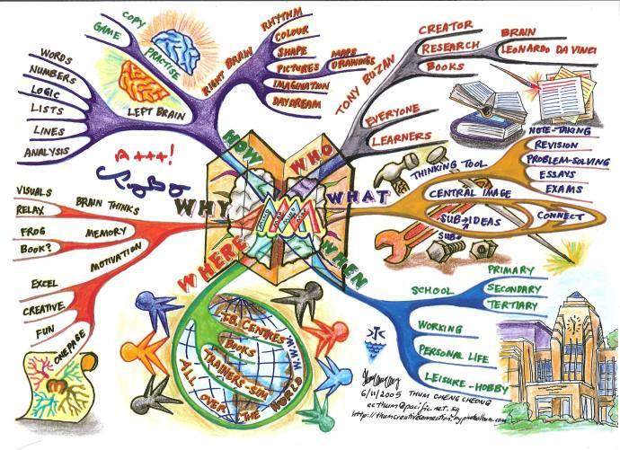
Mind map - example

Slide 9
Mind map – pen and paper
More resource-intensive (time and crayons)
good to battle boredom (at the meetings)
it can have artistic value (or not, depends on your talent :-)
In praxis we use rather software, because of
speed
standardized looks of the maps
possibilities to link maps between themselves and to the various resources

Slide 10
Mind maps - software
Graphical software – with support to draw mind maps (MS Visio, Smart Draw, ...)
Specialized software for mind maps creation (MindManager, FreeMind, ...)
specialized only on mind maps
not only graphics but other capabilities
sharing maps with others
connecting the maps
active links to other resources
collapsing/expanding nodes for effective work with large maps
creating map from the node, ...

Slide 11
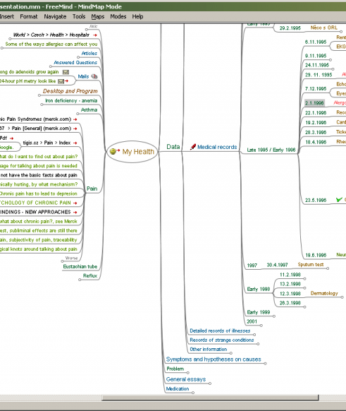
Free Mind
Open source
http://freemind.sourceforge.net/wiki/index.php/Main_Page
specialized on mind maps creation
functionally rich
created in Java
multi platform

Slide 12
Delphi method
Named after famous antic Oracle of Delphi
Developed by thinktank RAND for army
The method is not accurate!!! But sometimes we do not have available data to use more accurate methods
Uses surveys
We are surveying the specialist in certain field on the view in the problem domain
Relatively complex to evaluate gathered informations and interpret it

Slide 13
Advantages
We always get some results (but not necessary accurate results)
No hard data required (such as statistic data, numeric models results, ...)
We decide, how to interpret the gathered informations
We can influence results with the way we compose questions (both advantage and disadvantage)

Slide 14
Disadvantages
We interpret the gathered informations – sometimes we want (expect) to see pattern in results, and find it event if it is not there
We can influence results by way of composing questions
results are never accurate
worse - the results may be even outright wrong
main problems
dependence of specialists
bias

Slide 15
Typology of answers
Numeric
average, median, working with extreme values
Ordinal
frequency analysis
free text answer
hardest to evaluate
possible to identify common points in answers
identification of interesting ideas, different point of views

Slide 16
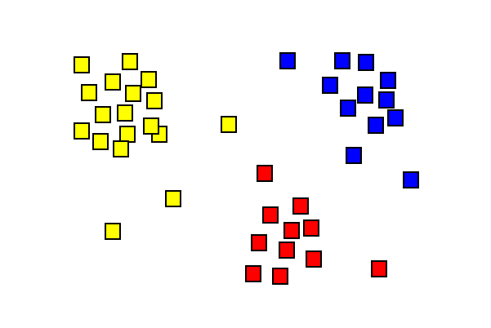
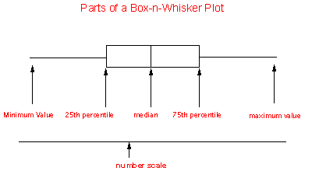
Evaluation is possible using graphs
Cluster analysis->
Box and Whisker graph

Slide 17
Bias
Question of independence (to who or what exactly?)
Major impact on evaluation of data
Also more universal implications to variety of problems
Humans tend to behave in different way, than we expect
Such behaviour can have not apparent inner consistency – it is possible to research it and understand it

Slide 18
Daniel Kahneman
Amos Tvertsky

Slide 19
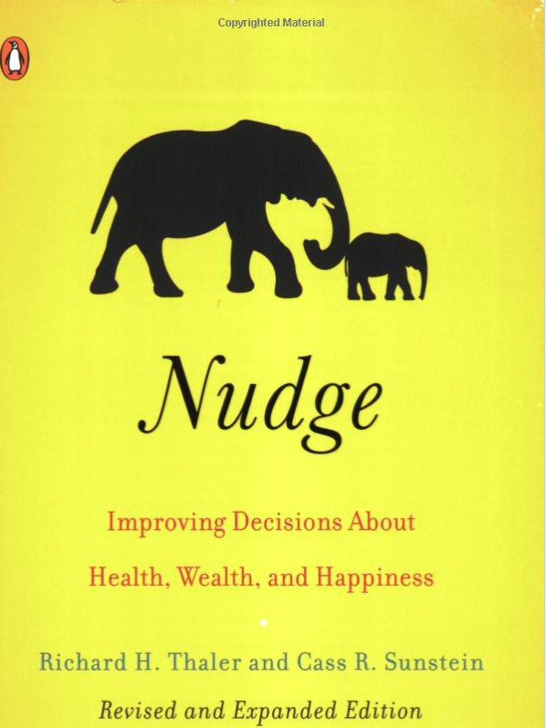
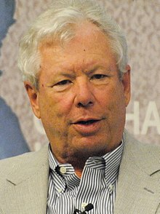
Richard H. Thaler

Slide 20
Bias
Specialist must be independent (to the answers)
Hypothetical bias
Respondent does not believe that the situation may happen in real world and has tendency to play it down
Strategic bias
Respondent firmly believes that the situation is real and that he may gain some benefits by formulating answers in certain way
Tool bias
We use tools (and methods) we are familiar with, not neccesarly the best tools/methods for task

Slide 21
Other problems
Experts tend to believe positive results and refuse negative results if these are gathered at later time
we do not like to change opinion
Also its hard to say „I was wrong“
Possibly similar problems may be on the side of person asking
Do we seek confirmation of our opinions
Or do we search for truth?

Slide 22
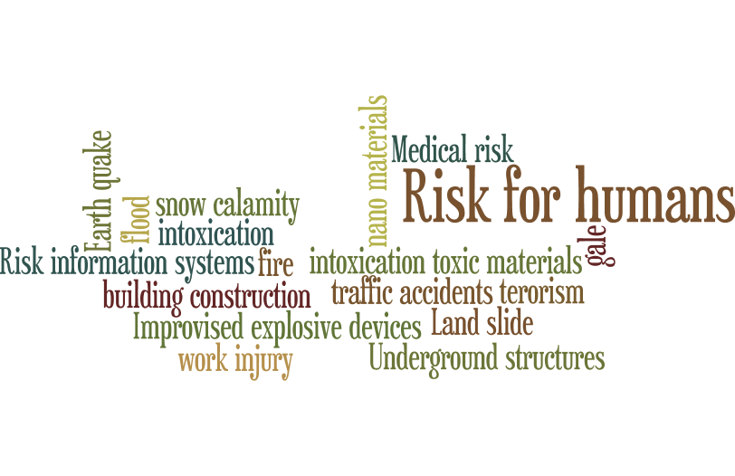
World cloud
http://www.wordle.net/advanced
Works only in Internet Explorer (java applet)
Earth~quake:50
fire:50
gale:50
intoxication:50
snow~calamity:50
work~injury:50
flood:50
intoxication~toxic~materials:50
traffic~accidents:50
Improvised~explosive~devices:50
Risk~for~humans:100
Land~slide:50
Medical~risk:50
Risk~information~systems:50
terorism:50
Underground~structures:50
building~construction:50
nano~materials:50

Slide 23
Sensitivity analysis
How to find whether the variable under consideration does influence the solution?
Sensitivity analysis explores haw is the solution sensitive to changes in values of the variables
How to do it? We change the value of the variable a explore how it impacts the solution. Other variables remain static (unchanged)

Slide 24
Outline of the analysis
Set possible range of variables (upper and lower limit)
01
Kvantification of the changed parameter impact
02
(not mandatory)
Visualization of the sensitivity using graphs
03
Result’s interpretation
04

Slide 25
How to do it for decision tree?
Mean value has been used originally
Limits were not known <– use i.e. expert estimation
Also possible the derive using statistic methods
 | variable | mean value (mil. EUR) | lower limit (mil. EUR) | uper limit (mil. EUR)
A | Epidemy - small costs | 280 | 250 | 310
B | Epidemy - middle costs | 400 | 360 | 440
C | Epidemy - large costs | 600 | 520 | 680
D | system of early warning | 120 | 100 | 140
E | vaccination (after alert) | 400 | 360 | 440

Slide 26
Sensitivity
Sensitivity is very low for textbook example
 | variable | cost lower limit (mil. EUR) | costs upper limit (mil. EUR) | cost difference (mil. EUR)
A | Epidemy - small costs | 378,75 | 383,25 | 4,5
B | Epidemy - middle costs | 372 | 390 | 18
C | Epidemy - large costs | 345 | 417 | 72
D | system of early warning | 400 | 440 | 40
E | vaccination (after alert) | 390 | 435 | 45

Slide 27
Sensitivity using tornado diagram
Tree 2
Epidemy – large costs
Vaccination (after alert)
Early warning system
N lower limit
N upper limit
Epidemy – middle costs
Epidemy – small costs

