Slide 1
Balance models
doc. Ing. Pavel Šenovský, Ph.D.
Modeling of Decision processes

Slide 2
Wassily Leontief
Prof. Wassily Leontief (1906-1999)
Since 1932 Harward University
1973 Nobel prize for economy
Model of general equilibrium
Input-output analysis

Slide 3
Input – output model
quantitative economic technique that represents the interdependencies between different branches of a national economy or different regional economies
Leontief used the model to quantify impact of the World War II on the Economy of USA
Method is usable also to not strictly economical problems – like evaluationg impact of large disruptions of infrastructure
See Hazus https://www.fema.gov/hazus

Slide 4
Input data – large problem
The tables describing „communication“ between branches of the economy are required
Its formulation is complicated – if attempted, it is available 5 – 7 years after
Data represent snapshot of the economy of that time
Not all countries even try

Slide 5
Where to next?
Since snapshot of the whole economy is complicated it is possible to simplify by analyzing smaller chunks of data, i.e. data of the region or a single company
This simplification leads to Balance models
Other approach - analyze only the connections, do not try to quantify it -> modelling of interconnections in critical infrastructure

Slide 6
Balance models - purpose
Definition
They are formalizing connections between basic materials, energetical requirements etc. of modeled system. Realization of these connections is required for transformation of the inputs to outputs.
Model form: systems of (usually linear) equations

Slide 7
How do we create model
Identification of the elements of the model
Identification of connection between them
Definition of parameters and variables of the model
Formulation and quantification of the model
Model solution

Slide 8
1. Identification of model elements
Products
Semi-finished product
Raw materials
fuel
energy
wrapping
…

Slide 9
Elements of model
Products and semi-products |  | Raw materials, fuel, energy
No. | Name | No. | Name
1 | Green RJ | 1 | Steam
2 | Green RP | 2 | Electrical energy
3 | Green khaki | 3 | Mirbam oil
4 | Green BJ | 4 | Antrachinon
5 | Zeleň BK | 5 | Benzoylchlorid
6 | Zeleň BK | 6 | Oleum
7 | Zeleň bx | 7 | Sulphuric acid
8 | Olive green B | 8 | Sulphate
9 | Olive green A | 9 | nitrogen
10 | Benzimidin | 10 | Amoniac water
11 | Diantrimid | 11 | Sulphide soda
12 | Benzatron | 12 | Kortamol
13 | Antrachinonsulfonan | 13 | Lye soda

Slide 10
2. Identification of connections

Slide 11
Definition of parameters and variables
Semi-products and products
y_{j} … production of j-product (or semi-product) for usage outside of the model
x_{j} …overall production of product j without looking at where it will go
x_{ij} …usage of product i for production of x_{j} units of the product j

Slide 12
Definition of parameters and variables
Material inputs
s_{i} …amouth of the matial needed to fullfill needs of the customers
x_{ij} = a_{ij} * x_{j} s_{i} = s_{ij} * x_{j}
where
a_{ij} … specific need of semiproduct i
s_{ij} … spec. Need of material inputs for unit of semi-product/product

Slide 13
Formulation and quantification of the model
Realization in two phases
Model of connection between the products
Balance model
(may be supported by capacity model)

Slide 14
Modeling of inter-product connection
Overall amount of produced final products equals the sum of customer needs (of the products) and its usage for production of the different products
x_{k} = x_{k1} + x_{k2} + … + x_{kn} or we can use x_{ij} from deffiniton of material inputs
x_{k} = a_{k1}x₁ + a_{k2}x₂ + … + a_{kn}x_{n}

Slide 15
Balance of inter-product connections
x₁ = a₁₁x₁ + a₁₂x₂ + … + a_{1n}x_{n}
x₂ = a₂₁x₁ + a₂₂x₂ + … + a_{2n}x_{n}
…
x_{n} = a_{n1}x₁ + a_{n2}x₂ + … + a_{nn}x_{n}

Slide 16
Balance model for amount of material input
s_{p} = s_{p1} x₁ + s_{p2}x₂ + … + s_{pn}x_{n}
s₁ = s₁₁x₁ + s₁₂x₂ + … + s_{1n}x_{n}
s₂ = s₂₁x₁ + s₂₂x₂ + … + s_{2n}x_{n}
…
s_{m} = s_{m1}x₁ + s_{m2}x₂ + … + s_{mn}x_{n}

Slide 17
Solution using IT
Usage of matrixes more appropriate
A square matrix of type (n, n) of specific usage of the semi-products a_{ij}. Majority of the matrix elements will equal to zero (semi-product is not used to produce product x_{i})
x vector of overall production of the product x_{j}.
y vector of production going outside of the model

Slide 18
Solution using IT
B matrix of type (m, n) consists of specific usage coef. of the material inputs needed to produce products and semi-products s_{ij}
s vector of overall needs of materials s_{i} we search for

Slide 19
Equations using the matrix
x = y + Ax
Model of usage of material and energetical inputs
Bx = s

Slide 20
Capacity model
Used for estimation of feasibility of the plan from capacity point of view
Cx = f
where
C … rectangle matrix of type (r, n), where r is number of machines, production lines …(usually in hours needed for production of the unit)
f … vector of the type (r,1) searched for requirements on length of use of the machines …

Slide 21
Specific needs of semi-products
Type | Inputs: energy, raw materials, semi-products | Specific need unit/t
green | Green BJ | 0,025
 | Green BB | 0,978
 | Kortamol | 0,03
 | electricity | 2,1
Green khaki | Green BK | 0,081
 | Green BX | 0,2
 | Kortamol | 0,15
 | electricity | 1,45

Slide 22
Model of inter-product connections
Balance of semi-products
Product | Balance equation
1 green RJ | x₁ = y₁
2 green RP | x₂ = y₂
3 green khaki | x₃ = y₃
4 green BJ | x₄ = y₄ + 0,025x₁
5 green BK | x₅ = y₅ + 0,81x₂ + 0,02x₃
Balance of raw materials and energy
 | Balance equations
steam | s₁ = 1,2x₈ + 17,5x₉ + 11x₁₀ + 32,5x₁₁ + 28x₁₂ + 24,5x₁₃
electricity | s₂ = 2,1x₁ + 0,95x₂ + 1,45x₃ + 1,45x₄ + 3x₂ + 1,3x₆ + 3x₇ + 1,45x₈ + 1,6x₉ + 1,2x₁₀ + 1,2x₁₁ + 1x₁₂ + 0,51x₁₃

Slide 23
Model expressed as matrix
x | y | A | x

Slide 24
Usage of raw materials
s | B | x

Slide 25
Capacity balance
 | 1 reactor | 2 reactor | 3 filtre | 4 mixer
lenght | f₁ | f₂ | f₃ | f₄
product | Specific needs of time hout/ton
Green RJ |  |  |  | 1,2
Green RP |  |  |  | 3,1
Green khaki |  |  |  | 2,2
Green BJ |  |  | 5,2
Green BK |  |  | 4,2
Green BB |  |  | 2,8
Green BX |  |  | 4,9
Olive green B |  | 14,2 | 2,0
Olive green A |  | 11,8 | 6,2
Benzimid | 7,2
Diantrimid | 4,9
Benzatron | 3,5
Antrachinosulfonan sodný | 5,6

Slide 26
Expressed as matrix
f | C | x

Slide 27
Solving balance model
x = [E - A]⁻¹y
Or [E - A]⁻¹ = U
x = Uy
Where
E … unit matric
U … square inverse matrix to matrix [E-A]⁻¹. Its elements u_{ij} are overall specific needs of semi-rpoducts for needs of production

Slide 28
Resulting matrix U

Slide 29
Application to Continuity management
Balance model allowed us to understands the structure of the production
By applying constrains to various components to simulate impact of the accident we gain capability to simulate impact to the production as whole
Interpretation of the results can be used as basis for planning for accident

Slide 30
IIM – input – output interoperability model
Mathematically very similar – original:
x = Ax + c
x = the Production Vector in individual economic sectors;
A = the Consumption Matrix that enables the definition of links between sectors;
c = the External Demand Vector for the outside of the modelled system

Slide 31
IIM
Simplifies the model – only connections between the sectors are established, so
x $∈$ <0; 1>
To model cascading effects
x = 0 -> represents complete break down of connected CI sector
x = 1 -> no effect (full functionality on CI sector)

Slide 32
IIM
Dependency index
(row summation)
The dependency index expresses the robustness of an infrastructure with respect to the inoperability of the other infrastructures
it represents the maximum inoperability in infrastructure i when every other infrastructure is fully inoperable

Slide 33
Dependency index - interpretation
. The greater the decrease in γi (when γi < 1), the better infrastructure i can maintain its working capabilities
Influence gain (column summation)
A large value of ρj means that the inoperability of j-th sector induces significant degradation to the system

Slide 34
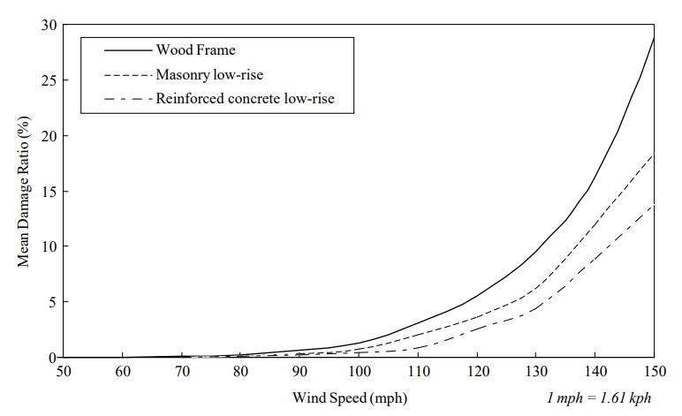
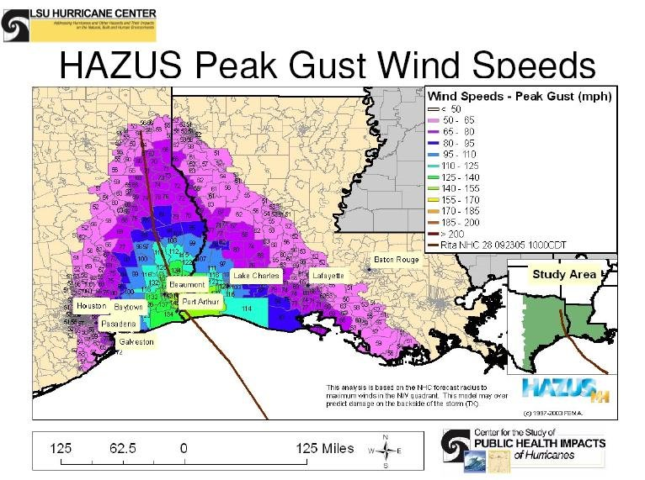
Hazus – different approach to hazard evaluation
Vulnerability curve
im
IIM
Impact on production
Damage to facility
Impact on other regions

