Slide 1
Surveys and Presenting Results
Modeling of Decision Processes
doc. Ing. Pavel Šenovský, Ph.D.

Slide 2
Problem domain
Target population
There are always more people in target population, then we technically can approach
How to find who to ask?
What exactly is target population?
How many people it is necessary to survey so the the survey results are representative?
Larger then required cover of the survey
Population not covered
by survey
Covered by survey

Slide 3
Outline of the survey
Survey design
1
Data gathering
2
Data modification
3
Data corection
4
Perform analysis
5
Publication/interpre-tation of the results
6

Slide 4
1 – survey design
What do we need to find in survey?
What is the goal?
Were hypotheses formulated – we need to verify those?
What are variables?
Target variables – connected to goal of the survey. We need to collect these to succeed
Additional variables – not necessary to solve problem, but make possible to stratify the answer (i.e. by gender, age, education, …)
Additional variables make possible to better understand why

Slide 5
2 – data gathering
Which questions and in which order?
Do we have to ask all questions?
Possibility to visualize
algorithm
UML
Can be used as basis of manual for persons doing the survey
Or as a basis of form automation in online surveys

Slide 6
3 – Data modification
Correcting errors
Errors in range – the data exist, but are obviously faulty (age: 200 years)
Errors in consistency – the data exist, but are contradicted in other answers of respondent
Errors in path taken in survey – the respondent answered questions, he should have not, or mandatory questions remained unanswered
What to do with missing data?
4 – Data correction
Throw out problematic surveys –> decreases credibility of results
Supply missing data reaching out to respondent (not possible In anonymous surveys)
Injecting value (random value, average or median value, …) – but in introduces errors into dataset

Slide 7
5 - Analysis
Graphical or tabular form
Both forms are complementary – do both (both do not need to be in the body of study – use annex)
Published data must be easy to understand – ideally without the need to study context in text.
Do graphs on following slide comply to these rules?

Slide 8
Bad graphs - example
Question number:
(a) histogram
(b) Pie chart
Figure 6.3: Histogram and pie chard (courtesy of [29])

Slide 9
Labels!
We have limited tools, but it is possible to improve the design
Graph label (i.e. Figure XY: Results of knowledge evaluation in the area of civil protection and crisis management of middle school students 2014)
Graph title (i.e. Knowledge testing in CP and CM – middle schools)
Graph axis labels (i.e. X axis – question number, Y axis – percentage of correct answers [%])
Legend for pie chart (and similar graphs)
The labels should work on their own – you should be capable to take the figure out of text and understand its content

Slide 10
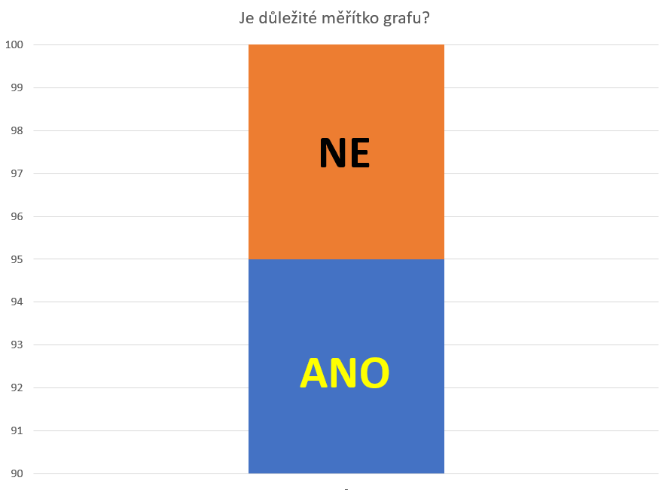
Graph proportionality
Is the scale of the graph important?
NO
How do you feel about this graph?
Look at Y axis – what does the graph really say?
So how should we interpret the data?
YES

Slide 11
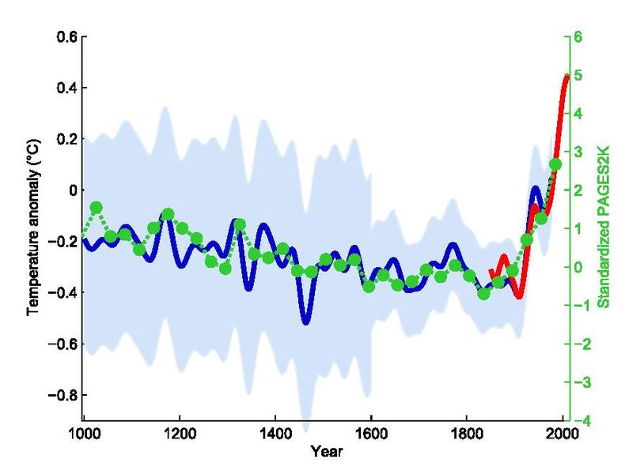
Hockey stick graph
Climatic changes
The variability of historical data is huge (pre 1800)
(indirect measurement used for these)
The information on graph can be correct, but they may mislead the reader
Possible solution – use two graphs
Measured values
Paleo – measures (indirectly measured)

Slide 12
Problematic predictions Winning times of 100m sprint on Olympic games

Slide 13
Graphs vs tables
Results in graphical form should not be the only data available
Reader may need different view on problem – you cannot comply to it after publishing the results
Data are usable for further studies
It’s easy to do – the data in tabular form are necessary for creation of graphs – so you have these available

Slide 14
Population
Parts of population identified by additional variable may be analyzed independently
What in case that we need to think about the population as whole?
So we compute averages and be done with it – right?
Yes … if the population used in survey is structurally same as the target population
… it‘s NO most of the time.
Usually we have to normalize the survey results for target population!
evaluation
students
students
adults
adults
sum
sum
Great
Good
sufficient

Slide 15
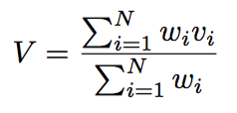
How to normalize?
The survey on last slide measured 125 students and 25 adults
In target population there are 313 130 middle school students and 8 665 578 adults
The survey covered 0,04% of students and 0,0003% of adults
In target population there is 3,5% of students and 96,5% adults
Presuming the measured results are representative (which they are not), it is possible to normalize:
Where
V = the variable for whole population
N = no of samples
w = weight of sample in target population

Slide 16
So how does it look like for our example?
Lets compute percentage of people with great knowledge in civil protection and crisis management

Slide 17
How to work with randomness?
What we measure is not the value but estimate of the value – there is error in the measurement
With luck the results will be close to the truth
We are working with subset of population – not with whole population
It is possible to use interval estimation of the mean value error
Where
E = error, z = crit. Value of normal distribution for
α = level of trust
σ = standard deviation
n = no of measures
Usage for numeric values

Slide 18
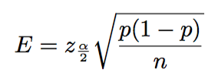
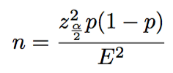
Ordinal data
p = estimation of correct value of the variable
Other symbols remain same

Slide 19
No. of respondents for survey
To make previous assertion (about the percentage of population with great knowledge …)
If the result should be in the confidence interval 95%
With expected error max. 4%
Estimation of p value is 31% (as measured)
Result is approximately 514 respondents (but the survey asked 25 only!)

