Slide 1
Networks II
Computation Software
Doc. Ing. Pavel Šenovský, Ph.d.

Slide 2
Basics of usage of computational software

Slide 3
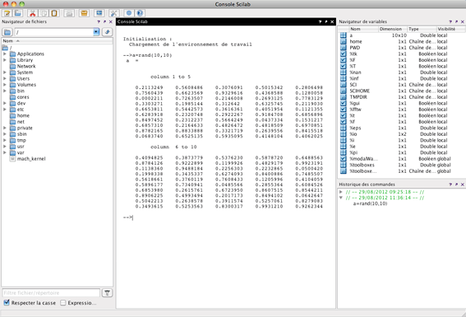
Computation packages - What is available
SciLab
  Open source: http://www.scilab.org/
  Mostly compatible with MathLab
  Main differences are in available packages
R
  Open source: https://www.r-project.org/
  Statistical analysis, datamining, analysis in general
  Install distribution of R, then install specialized packages from repositories
  Relatively difficult to learn, but universal – can be used on everything from PC to supercomputer
  Huge body of literature available – lot of it free of charge

Slide 4

Scilab usage, principles … by example understanding effectivity of systEm in time
W(k) … function of evaluated system parameter
y … years
r … discount rate
To get high quality output export to vector PDF
$$W\left(k\right)=\frac{W(k,y)}{{(1+r)}^{y}}$$

Slide 5
Scilab scriPt
y=(1:1:20); //from 1 to 20 with step 1 (from:step:to) -> result is vector
r1 = 0; //scalar value
r2 = 0.02; //semicolon means than no output in the SciLab window is displayed
r3 = 0.05;
w1 = 100 ./ ((1 + r1).^y); // symbol ./ means division of vector members (net division of vectors)
w2 = 100 ./ ((1 + r2).^y); //analogically .^ means member-wise power
w3 = 100 ./ ((1 + r3).^y);
plot(w1, 'b'); //simplest graph function – plot(what, 'color')
plot(w2, 'r'); //plot commands build upon each other – this line adds to plot another curve w2
plot(w3, 'g');
title("Degradation of system in years"); //set graph properties
xlabel("years");
ylabel("efectivity [%]");
legend(["r = 0 %"; "r = 2 %"; "r = 5 %"]); //legend parameter is also vector, no of its members = no of plots in graph
set(gca(), "data_bounds", matrix([1,20,30,105],2,-1)); //set axis bounds (what will be visible in graph)

Slide 6

Critical vulnerability of networks with different spectral radius
$\log\left(q\right)=b−kγρ$
Where q … resilience, γ … vulnerability, ρ … network’s spectral radius, b, k … network specific constants
Resilient networks have small spectral radius (~4), higly organized networks have large spectral radius (road network Netherlands 57, Internet 117, …)
Critical point of network –> resilience = 0
$b−kγρ=0$
Critical vulnerability:
$γ_{0}=\frac{b}{kρ}$

Slide 7
SciLab script
b = 1;
b2 = 0.32;
k = 1;
k2 = 0.25;
ro = 4:150;
gama = (b * 100) ./ (k * ro);
gama2 = (b2 * 100) ./ (k2 * ro);
plot(ro, gama, 'b');
plot(ro, gama2, 'r');
title("Dependence of critical vulnerability on spectral radius of the network");
xlabel("spectral radius of the network");
ylabel("critical vulnerability of the network [%]");
legend(["b=1, k=1"; "b=0,32, k=0,25"]);

Slide 8

Example 3d graph – dependence of mortality on speed of flow and high of the flooding
Empiric model <- based on studies with stability of people in the current under different circumstances
Empiric data generalized into form of statistical models
Limited usability – but better then nothing
$f_{ng}=\min\left(max⁡({8,5e^{0,6h−6}−0,15;0}\right);1)∙min⁡(\max\left(8,5e^{1,2v−4,3}−0,15;0\right);1)$

Slide 9
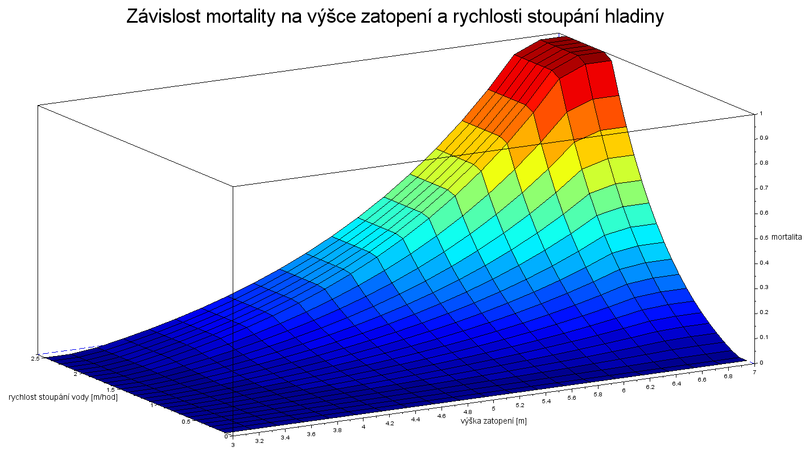
3D plot
h = 3:0.2:7;
v = 0.1:0.1:2.5;
vyska = min(max(8.5 * exp(0.6 * h - 6) - 0.15,0), 1);
rychlost = min(max(8.5 * exp(1.2 * v - 4.3) - 0.15, 0), 1);
fng = vyska' * rychlost;
plot3d(h, v, fng, alpha=0, theta=270);
xlabel("high of flooding [m]", "fontsize", 3);
ylabel("speed water of rising [m/hod]", "fontsize", 3);
zlabel("mortality", "fontsize", 3);
title("Dependence of mortality on speed of water raising", "fontsize", 6);
e = gce(); // Get current entity handle.
e.color_flag = 1; // Color according to z
f = gcf();
f.color_map = jetcolormap(32);

Slide 10
Networks

Slide 11
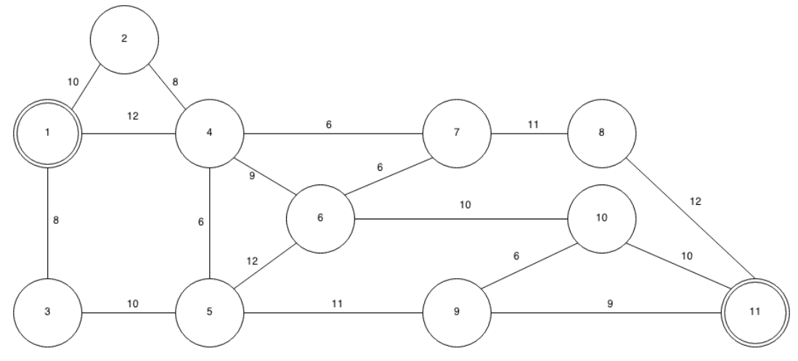
Network to Experiment With

Slide 12
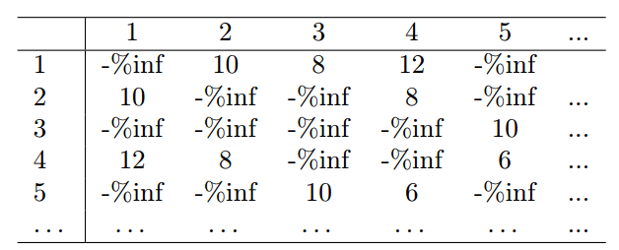
Numerical representation of the network
2 basic ways to represent the network
  Using matrix (see right)
  Using list of graph edges (with evaluated properties)
List of edges is more scalable
The no of matrix elements grows exponentially with number of the edges
But both representations are usable
Matrix
List of edges:
list([1, 2, 10], [2, 4, 8], [1, 4, 12], [1, 3, 8], [3, 5, 10], [4, 5, 6])

Slide 13
Numeric solution of networks in Scilab
SciLab’s preinstalled packages do not include functions to solve this kind of problems
There is available package Numerics at http://www.ruhr-uni-bochum.de/num1/softwareE.html
The package is primary intended to implement algorithms used in Numerics courses, which includes Dijsktra and Ford-Fulkerson algorithms (but also problems of numeric integration and other)
The package
  Must be downloaded and unziped in folder of choice
  Inside SciLab the package must be connected before using its functions:
  mylib = lib(path) //complete path to the unziped package
  numerics_help() //obtain a short help concerning the functionality of the implemented functions
  ford_fulkerson(net,first,last)
  dijkstra(net,first,last)

Slide 14
Capacity problem and Shortest path
mylib=lib("/Users/pavelsenovsky/Numerics");
net = list([1,2,10], [2,4,8], [1,4,12], [1,3,8], [3,5,10], [4,5,6], [4,7,6], [4,6,9], [5,6,12], [7,8,11], [8,11,12],
[6,10,10], [10,11,10], [5,9,11], [9,10,6], [9,11,9]);
first=1;
last=11;
ford_fulkerson(net,first,last)
dijkstra(net,first,last)
in our case the result is 25 and 38 for shortest path

Slide 15
Using software R
Slightly different philosophy
Huge amount of packages
Flexibility to use different input formats for graph definition
  Edge list
  GraphML
  Different types of notation allow for different properties of graph – question, what exactly do you need?
For graphs manipulation package igraph
  Usable for both computation and drawing of the graph

Slide 16
Edge list
Easy to do CSV format
CSV = Comma separated values
In this case replace coma with space
Each edge is on separate line
Format
Start_node end_node property
Property can be capacity/length
CSV file for our experimental network:
1 2 10
2 4 8
1 4 12
1 3 8
3 5 10
4 5 6
4 7 6
4 6 9
5 6 12
7 8 11
8 11 12
6 10 10
10 11 10
5 9 11
9 10 6
9 11 9

Slide 17
GraphML
Based on XML (Extensive mark-up Language)
Full specification http://graphml.graphdrawing.org/
Most software packages implement only subsets of the standard
Necessary to learn what is (or is not) supported by the tool you use
Basic structure of the file:
<?xml version="1.0" encoding="UTF-8"?>
<graphml xmlns="http://graphml.graphdrawing.org/xmlns"
xmlns:xsi="http://www.w3.org/2001/XMLSchema-instance"
xsi:schemaLocation="http://graphml.graphdrawing.org/xmlns
http://graphml.graphdrawing.org/xmlns/1.0/graphml.xsd">
… graph definition goes here
</graphml>

Slide 18
graphML - constructors
key – defines property of the edges (in general terms) – used in data
  <key id="d1" for="edge" attr.name="weight" attr.type="double"/>
graph – used for graph definition (type, node, edge and data go inside)
  <graph id="G" edgedefault="undirected">
  …
  </graph>
node – used for definition of the nodes in the graph (all nodes must be defined before using them in edge)
  <node id="n1"/>

Slide 19
GRAPHML – Constructors II
edge – definition of the edge of the graph
data – used to store edge property (ie length)
<edge source="n1" target="n2">
<data key="d1">10.0</data>
</edge>

Slide 20
Whole GraphML file for experimental network
<edge source="n4" target="n5">
<data key="d1">6.0</data>
</edge>
<edge source="n4" target="n6">
<data key="d1">9.0</data>
</edge>
<edge source="n5" target="n6">
<data key="d1">12.0</data>
</edge>
<edge source="n4" target="n7">
<data key="d1">6.0</data>
</edge>
<edge source="n6" target="n7">
<data key="d1">6.0</data>
</edge>
<edge source="n7" target="n8">
<data key="d1">8.0</data>
</edge>
<edge source="n8" target="n11">
<data key="d1">12.0</data>
</edge>
<edge source="n6" target="n10">
<data key="d1">10.0</data>
</edge>
<edge source="n10" target="n11">
<data key="d1">10.0</data>
</edge>
<edge source="n5" target="n9">
<data key="d1">11.0</data>
</edge>
<edge source="n9" target="n10">
<data key="d1">8.0</data>
</edge>
<edge source="n9" target="n11"/>
</graph>
</graphml>
<?xml version="1.0" encoding="UTF-8"?>
<graphml xmlns="http://graphml.graphdrawing.org/xmlns"
xmlns:xsi="http://www.w3.org/2001/XMLSchema-instance"
xsi:schemaLocation="http://graphml.graphdrawing.org/xmlns
http://graphml.graphdrawing.org/xmlns/1.0/graphml.xsd">
<key id="d1" for="edge" attr.name="weight" attr.type="double"/>
<graph id="G" edgedefault="undirected">
<node id="n1"/>
<node id="n2"/>
<node id="n3"/>
<node id="n4"/>
<node id="n5"/>
<node id="n6"/>
<node id="n7"/>
<node id="n8"/>
<node id="n9"/>
<node id="n10"/>
<node id="n11"/>
<edge source="n1" target="n2">
<data key="d1">10.0</data>
</edge>
<edge source="n1" target="n4">
<data key="d1">12.0</data>
</edge>
<edge source="n1" target="n3">
<data key="d1">8.0</data>
</edge>
<edge source="n2" target="n4">
<data key="d1">8.0</data>
</edge>
<edge source="n3" target="n5">
<data key="d1">10.0</data>
</edge>

Slide 21
R script to compute the file
# hash is considered comment
library(igraph) #load igraph package
sit <- read.graph("/Users/pavelsenovsky/Documents/skripta/modelovani 3vyd/skripty/sit.graphml", "graphml")
#huge benefit of using igraph is that it „knows“ lot of graph formats – no need to transform it outside R
plot(sit) #R is capable to automaticaly generate graph with properties (very powerfull tool)
shortest.paths(sit, 1, 11) #numeric computation of shortest path
get.all.shortest.paths(sit, 1, 11)

Slide 22
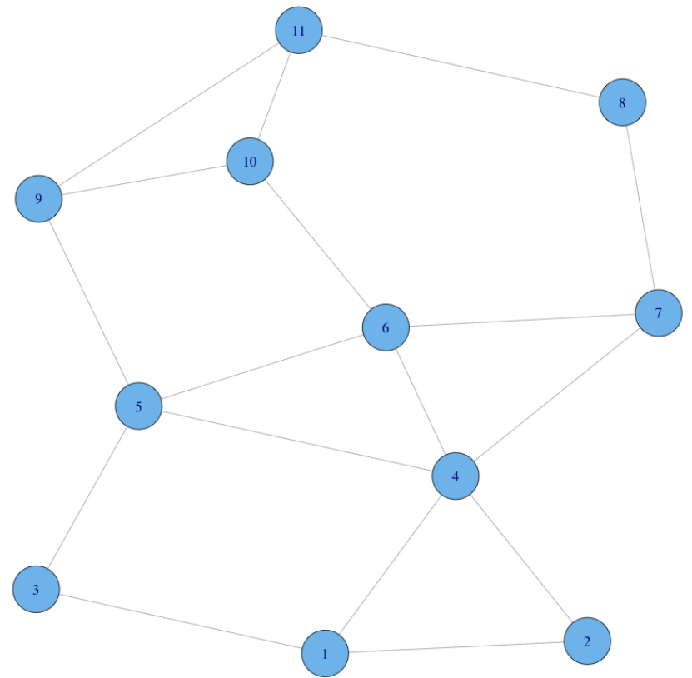
Generated graph
Graph may be generated in many different ways using R
Graph capabilities are one of most confusing problems for R users
There exist whole textbooks on graph generation in R!
Consider using different programs for visualization of data
Many open source available
  Gephi https://gephi.org/
  Cytoscape http://www.cytoscape.org/
  Many others

