Slide 1
MCA – Multicriterial Analysis
Modeling of Decision Processes
doc. Ing. Pavel Šenovský, Ph.D.

Slide 2
MCA
Sometimes one criterion is not enough
Decision trees can work with multiple criteria, but it is not elegant
Tree for every single criterion needs to be computed
Then it is required to aggregate them
Existence of various connected problems as
Different units
Existence of bias
Necessity to work with both utility and risks connected to choice
MCA is one of methods addressing such issues

Slide 3
MCA
Multiple methods are being used in the praxis
The MCA we are talking today supports the decision by comparing the „distance“ to optimum
Many methods work like that:
Electre (I, II, III, …)
Promethee
Topsis
Lecture demonstrates principles these are based on
There are decision support packages implementing these methods (and many others)

Slide 4
MCA - outline
Statement of the problem
Information gathering
Analytic information
Thematic information
Utility evaluation
Risk evaluation
Final evaluation
Formulation of recomendations
Works well in general outline of the problem solution we established in previous lecture for decision trees

Slide 5
Utility evaluation 1. quantifying criteria
Criteria in their natural units
Variants are labeled neutrally as V1 – Vn
Direct comparison of criteria not possible
(comparing apples and pears)

Slide 6
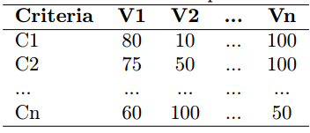
2. Table of simple utility
Generally: we need to normalize the criteria
I. e. criteria value as % of utility
0 = no utility
100 = max. utility
The transformation from natural units may be linear or more complicated
i.e. size of display for mobile phone – bigger = better… up to certain size
Transformation process must be documented!

Slide 7
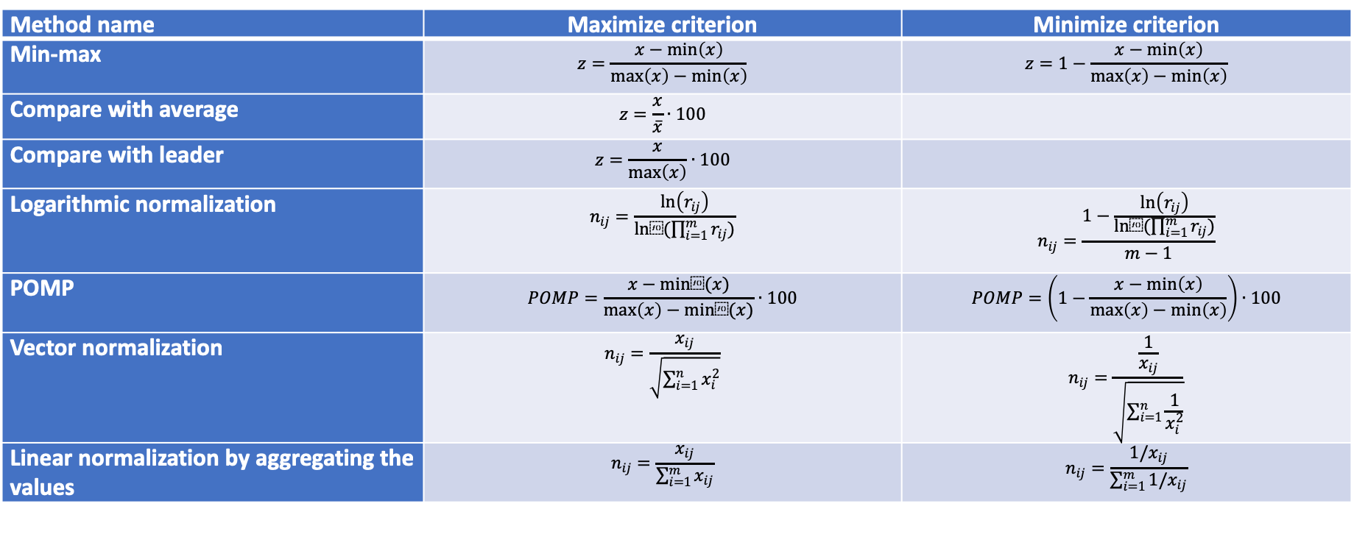
Other normalization methods
Method name | Maximize criterion | Minimize criterion
Min-max | $$z=\frac{x−\min\left(x\right)}{\max\left(x\right)−\min\left(x\right)}$$ | $$z=1−\frac{x−\min\left(x\right)}{\max\left(x\right)−\min\left(x\right)}$$
Compare with average | $$z=\frac{x}{\overline{x}}∙100$$
Compare with leader | $$z=\frac{x}{\max\left(x\right)}∙100$$
Logarithmic normalization | $$n_{ij}=\frac{\ln\left(r_{ij}\right)}{ln⁡(\prod_{i=1}^{m}{r_{ij})}}$$ | $$n_{ij}=\frac{1−\frac{\ln\left(r_{ij}\right)}{ln⁡(\prod_{i=1}^{m}{r_{ij})}}}{m−1}$$
POMP | $$POMP=\frac{x−min⁡(x)}{\max\left(x\right)−min⁡(x)}∙100$$ | $$POMP=\left(1−\frac{x−\min\left(x\right)}{\max\left(x\right)−\min\left(x\right)}\right)∙100$$
Vector normalization | $$n_{ij}=\frac{x_{ij}}{\sqrt{\sum_{i=1}^{n}{x_{i}^{2}}}}$$ | $$n_{ij}=\frac{\frac{1}{x_{ij}}}{\sqrt{\sum_{i=1}^{n}{\frac{1}{x_{i}^{2}}}}}$$
Linear normalization by aggregating the values | $$n_{ij}=\frac{x_{ij}}{\sum_{i=1}^{m}{x_{ij}}}$$ | $$n_{ij}=\frac{1/x_{ij}}{\sum_{i=1}^{m}{{1/x}_{ij}}}$$

Slide 8
Normalization
You can choose even arbitrary created set of transformational rules
Regardless of what you choose you need to be capable to defend it
Examples of usage:

Slide 9
Comparing the criteria
Are all criteria independent or do the form hierarchy (or network)?
MCA in lecture expects independent criteria
If it is not the case – we have to perform analysis in different way
Use for example:
AHP – Analytic Hierarchy Process
ANP – Analytic Network Process
(superdecisions.com)

Slide 10
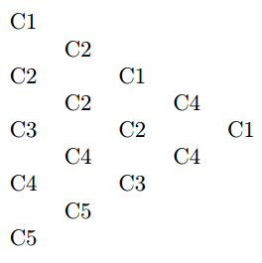
Deriving the weights of the criteria
Different criteria contribute differently to decision
Need to establish weight for criteria
There are lots of methods
We focus on pairwise comparison
Fuller triangle
Binary comparison
Compare every pair of criteria and add a point to preferred one
No. of preferences will lead to establishment of order based on their importance

Slide 11
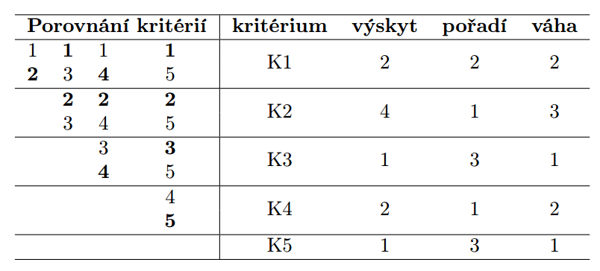
Alternative approach using Fuller’s triangle
Compare criteria
Criterion
Count
Order
Weight

Slide 12
Alternative methods to establish weight system
Directly state order of the criteria
Direct valuing of the criteria „importance“ using points
Budget allocation method
Derive weights from allocated points
$w_{i}=\frac{p_{i}}{\sum_{j=1}^{n}{p_{j}}}$
Where p = points, w = weights

Slide 13
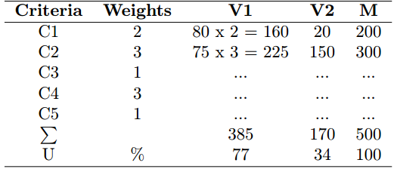
3. Table of weighted criteria
Weighted criteria are comparable and also consider different contribution of criteria to decision
Added column M for theoretical maximal utility variant
M will be considered = 100%
Variants will be compared to it
First results of our analysis
Please note, that if weights have been normalized (as described by equation on previous slide), neither M or U needs to be computed and SUM of the weighted criteria, for the variant is the Utility sufficient enough to establish order of the variants.

Slide 14
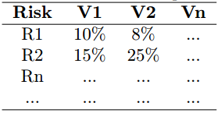
Risk evaluation – table of risks
Similar to working with utility
Value of risk is already in %
Be careful to what time period is risk connected
3% per year <> 3% per decade
(3x per 100 years vs 3x per 1000 years)
It needs to be scaled to same time period

Slide 15
Weighted risks
Risk are also weighted
R = Probability * Consequence
Probability is already established
Weights will represent the consequence part of risk
Again Vmax is computed
Other variants are compared to it

Slide 16
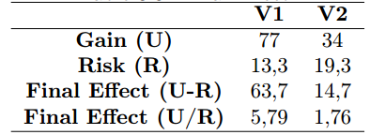
Final effect
Utility vs risks
Utility – risks
Utility / risks
May lead to different order of the variants
Strategies
Maximal – maximize utility
Minimal – minimize risks
Optimal – use final effect
Possible to form alternatives to recomendations

Slide 17
Example – choosing e-book reader
Statement of the problem:
Recomend e-Ink e-book reader, for the reading of beletry. E-books will be in e-book formate (either epub or mobi), the usage of PDF format is not required and we do presume, that the PDF format will not be used for reading on the device.
Analytic information
Display size (5, 6, 9.7 in)
Display type Peal/Carta
Wi-fi
Support for mobi/epub
SD card support
Thematic information
Use tablet or large mobile phone
Paper books rule supreme
…

Slide 18
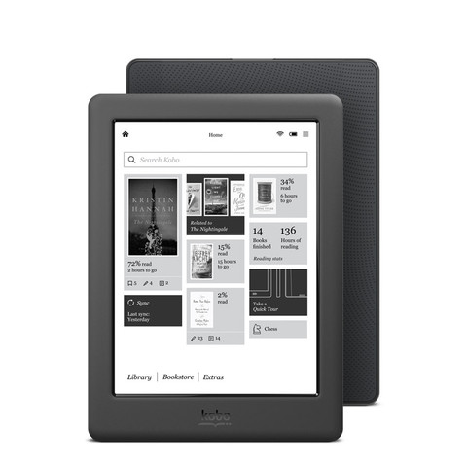
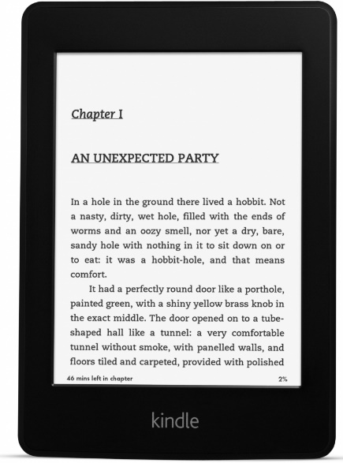
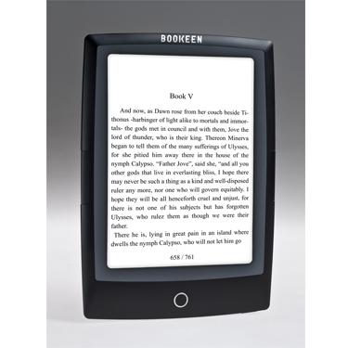
Identified Variants for E-Ink E-book Reader
V1 – Kobo Glo
V2 - Sony Reader PRS-T3
V3 - Amazon
Kindle
Paperwhite 2
V4 - Pocketbook
Touch Lux
V5 - Bookeen Cybook
Odyssey HD FrontLight

Slide 19
Variants
V1 - Kobo Glo
V2 - Sony Reader PRS-T3
V3 - Kindle Paperwhite 2
V4 - Pocketbook Touch Lux
V5 - Bookeen Cybook Odyssey HD FrontLight

Slide 20
Criteria in natural units
Criteria | Units | V1 | V2 | V3 | V4 | V5
K1 Display | - | Pearl | Pearl | Carta | Pearl | Pearl
K2 Weight | g | 185 | 200 | 206 | 198 | 180
K3 touch UI | Y/N | Y | Y | Y | Y | Y
K4 HW buttons | Y/N | N | Y | N | Y | Y
K5 front light | Y/N | Y | N | Y | Y | Y
K6 battery | No. page turns | 2100 | 1700 | 1700 | 1700 | 1900
K7 wi-fi | Y/N | Y | Y | Y | Y | Y
K8 price | Kč | 3400 | 3800 | 3300 | 3400 | 4200

Slide 21
Criteria utility
Criteria | V1 | V2 | V3 | V4 | V5
K1 Display | 80 | 80 | 100 | 80 | 80
K2 Weight | 97 | 88 | 85 | 90 | 100
K4 HW buttons | 50 | 100 | 50 | 100 | 100
K5 front light | 100 | 20 | 100 | 100 | 100
K6 battery | 100 | 70 | 70 | 70 | 85
K8 price | 94 | 70 | 100 | 94 | 50

Slide 22
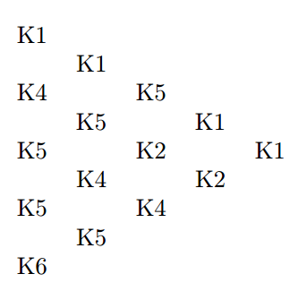
Pairwise comparison
criteria | Freq. | Order | Weight
K1 Display | 4 | 1 | 5
K2 Weight | 2 | 3 | 3
K4 HW buttons | 3 | 2 | 4
K5 front light | 4 | 1 | 5
K6 battery | 1 | 4 | 2
K8 price | 0 | 5 | 1

Slide 23
Weighted utility
Criteria | Weight | V1 | V2 | V3 | V4 | V5 | M
K1 Display | 5 | 400 | 400 | 500 | 400 | 400 | 500
K2 Weight | 3 | 291 | 264 | 255 | 270 | 300 | 300
K4 HW buttons | 4 | 200 | 400 | 200 | 400 | 400 | 400
K5 front light | 5 | 500 | 100 | 500 | 500 | 500 | 500
K6 battery | 2 | 200 | 140 | 140 | 140 | 170 | 200
K8 price | 1 | 94 | 70 | 100 | 94 | 50 | 100
SUM |  | 1685 | 1374 | 1695 | 1804 | 1820 | 2000
Utility | % | 84,25 | 68,7 | 84,75 | 90,2 | 91 | 100

Slide 24
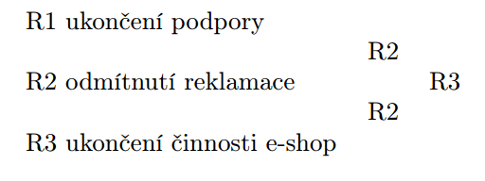
Risks establishment and pairwise comparison
Risks | V1 | V2 | V3 | V4 | V5
R1 | 40 | 30 | 5 | 10 | 10
R2 | 30 | 30 | 5 | 40 | 10
R3 | 40 | 40 | 0 | 30 | 40
R1 - Premature end of support for the device by producer
R2 - Denying complaint for broken screen
R3 - End of life of the book e-shop integrated into the reader

Slide 25
Risk – establishing weights
Risks | Freq. | Order | Weight
R1 | 0 | 3 | 1
R2 | 2 | 1 | 3
R3 | 1 | 2 | 2

Slide 26
Table of weighted risks
Risks | Weight | V1 |  | V2 |  | V3 |  | V4 |  | V5 |  | Vmax
 |  | p | GT | p | GT | p | GT | p | GT | p | GT | p | GT
R1 | 1 | 0,4 | 0,4 | 0,3 | 0,3 | 0,05 | 0,05 | 0,1 | 0,1 | 0,1 | 0,1 | 1 | 1
R2 | 3 | 0,3 | 0,9 | 0,3 | 0,9 | 0,05 | 0,05 | 0,4 | 1,2 | 0,1 | 0,3 | 1 | 3
R3 | 2 | 0,4 | 0,8 | 0,4 | 0,8 | 0 | 0 | 0,3 | 0,6 | 0,4 | 1,2 | 1 | 2
SUM |  |  | 2,1 |  | 2 |  | 0,1 |  | 1,9 |  | 1,6 |  | 6
GT | % |  | 35 |  | 33,3 |  | 1,7 |  | 31,7 |  | 26,7 |  | 100

Slide 27
Final Effect
 | V1 | V2 | V3 | V4 | V5
Utility | 84,25 | 68,7 | 84,75 | 90,2 | 91
Risks | 35 | 33,3 | 1,7 | 31,7 | 26,7
U - R | 49,25 | 35,4 | 83,05 | 58,5 | 64,3
U/R | 2,4 | 2,1 | 49,9 | 2,8 | 3,4

