Slide 1
Introduction to Decision Making
What is decision, influence diagrams a monocriterial methods
doc. Ing. Pavel Šenovský, Ph.D.

Slide 2
Decision
Decision is conscious or unconscious choice
Choosing presumes existence of the variants leading to goal, but different in utility and costs attached to it
Decision making <- optimization problem
The problem
Variants of the solution are not always known
Distinguishing between them is not always easy
Decision goal is not always easily specified in measurable manner

Slide 3
Decision situation
Difference in predictability of decision result
Deterministic – known results, without probabilistic elements
Stochastic
More common in real life
The result of the decision is characterized by utility value and probability of it happening
Necessity to evaluate whole fan of probability
(so more complex to evaluate)

Slide 4
Hierarchy and structure of the decision
By the decision we aim to fulfill a goal or goals
The goals may be achievable by various methods and may
Support each other
Or work against each other (in extreme be mutually exclusive)
Each decision situation has its goal hierarchy.
Consider maximizing safety of car traffic
What goals do you have?
Who has the ability to achieve them?

Slide 5
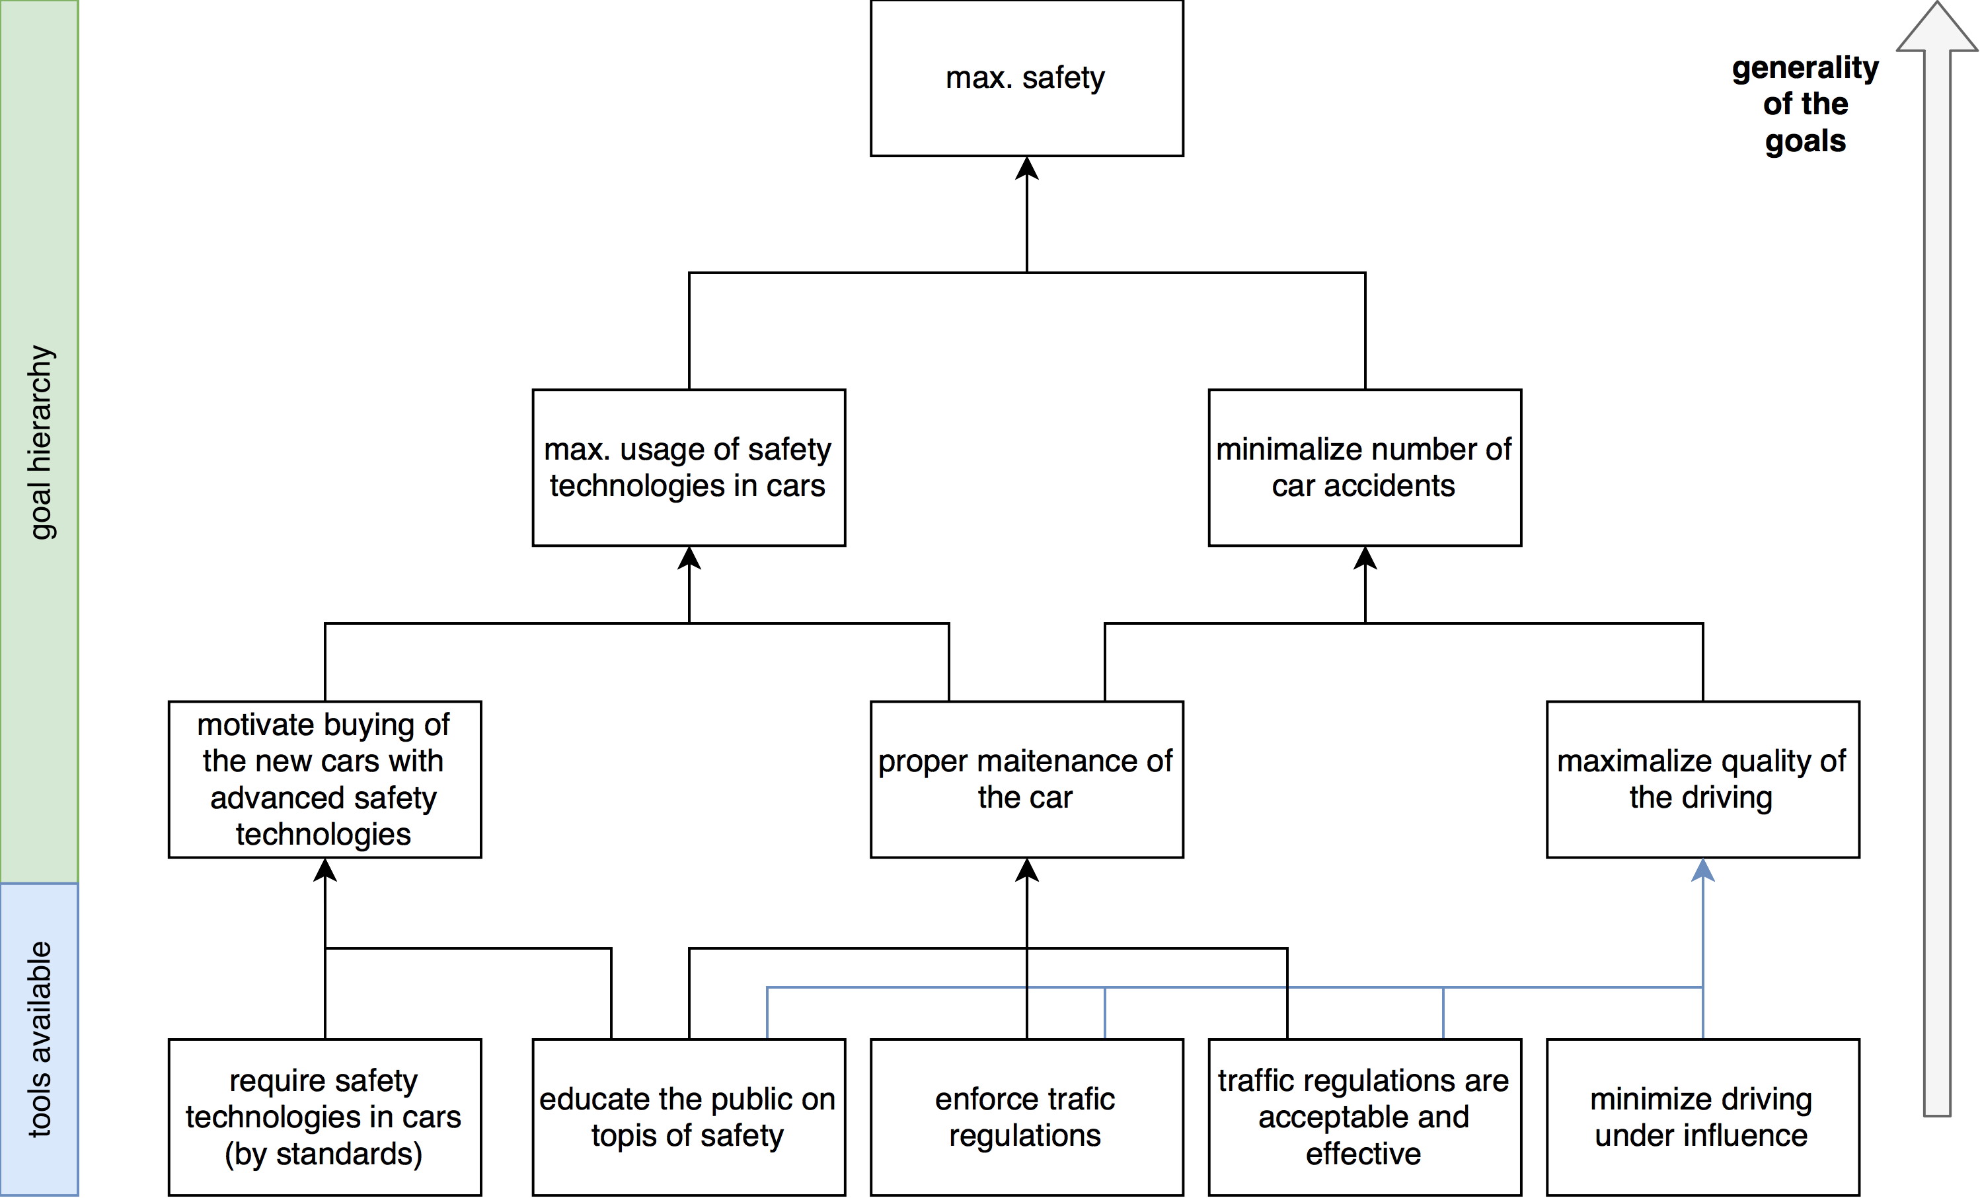
Goal hierarchy of car traffic safety
Who decides (point of view)?
Driver?
Car manufacturer?
Ministry of transportation?
…

Slide 6
Decision context
Where exactly in the goal hierarchy are we and what tools do we have available
In context of the “business” – decision making in organizations
What groups of workers/managers … should be part of decision process
What are their respective goals in the decision situations
Who has the knowledge in problem domain?
The manager
formulates the problem,
puts together team
allocates resources
Uses the results of the analysis to make a decision

Slide 7
Decision phases
Statement of the problem
Getting to know the problem
Identification of the criteria
Gathering information about the variants
Choose method
Perform analysis
Interpret results
Analysis itself is not always success
Sometimes it is necessary to do more than one iteration
Each iteration contributes to knowledge about the problem
Success is not guaranteed
More than one method may be needed

Slide 8
Methods
What exactly should be the result of method usage?
Better understanding of the problem?
Or finding optimal solution to the problem – choosing optimal variant of solution?
If solution needs to be found – are we optimizing against single criterion or multiple criteria?
If multiple criteria – how do we establesh respactive weights of the criteria
There is no single universally usable solve it all method
Choosing the right method is first step to problem solution

Slide 9
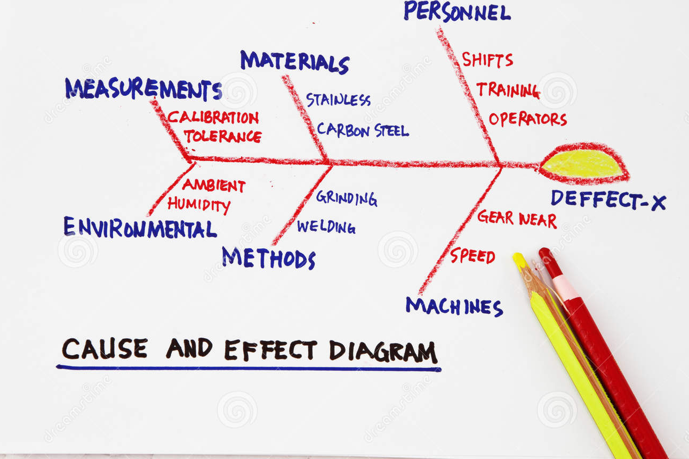
Beginning of the decision making
Tools to better understand the situation and its properties - methods
Brainstorming and mind maps (both separate lecture)
Also well known methods like SWOT analysis or Ishikawa diagram
Many other methods
These method do not usually present solution of the problem!

Slide 10
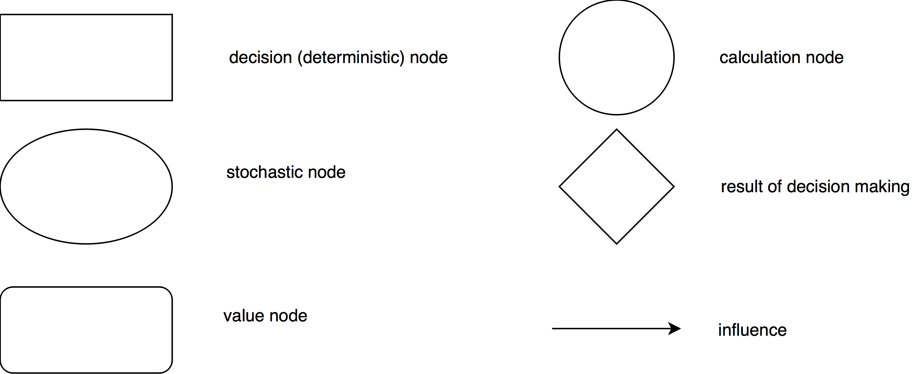
Influence diagrams
Easy to understand diagrams describing influence of various factors on decision making
constructors:

Slide 11
Influence diagram example

Slide 12
Example 2 + remarks
Influence of various factors on obesity
http://www.shiftn.com/obesity/Full-Map.html
Not all type of nodes need to be used (depending on your needs)
Proper presentation of the results can help
Clarify your point of view
Better communicate problem
And … to influence people ☺

Slide 13
Presenting the analysis results
Difficult decision problems require participation of knowledge-wise broad teams
Members of the team are not persons making the decision
The results of the analysis must be presented
In form understandable for persons not skilled in decision problem domain
Must be short
Results must be defendable (every step taken)

Slide 14
Decision trees
Monocriterial method
As opposed to methods presented before this one actually allows to choose optimal solution to the problem
The criterium can be:
Utility (in monetary terms or the unit of choice) – maximize
Costs – minimize
Risk – minimize
Other unit (minimize/maximize depending on decision situation)
Presumption, that other criteria (if they exist) do not influence significantly the decision

Slide 15
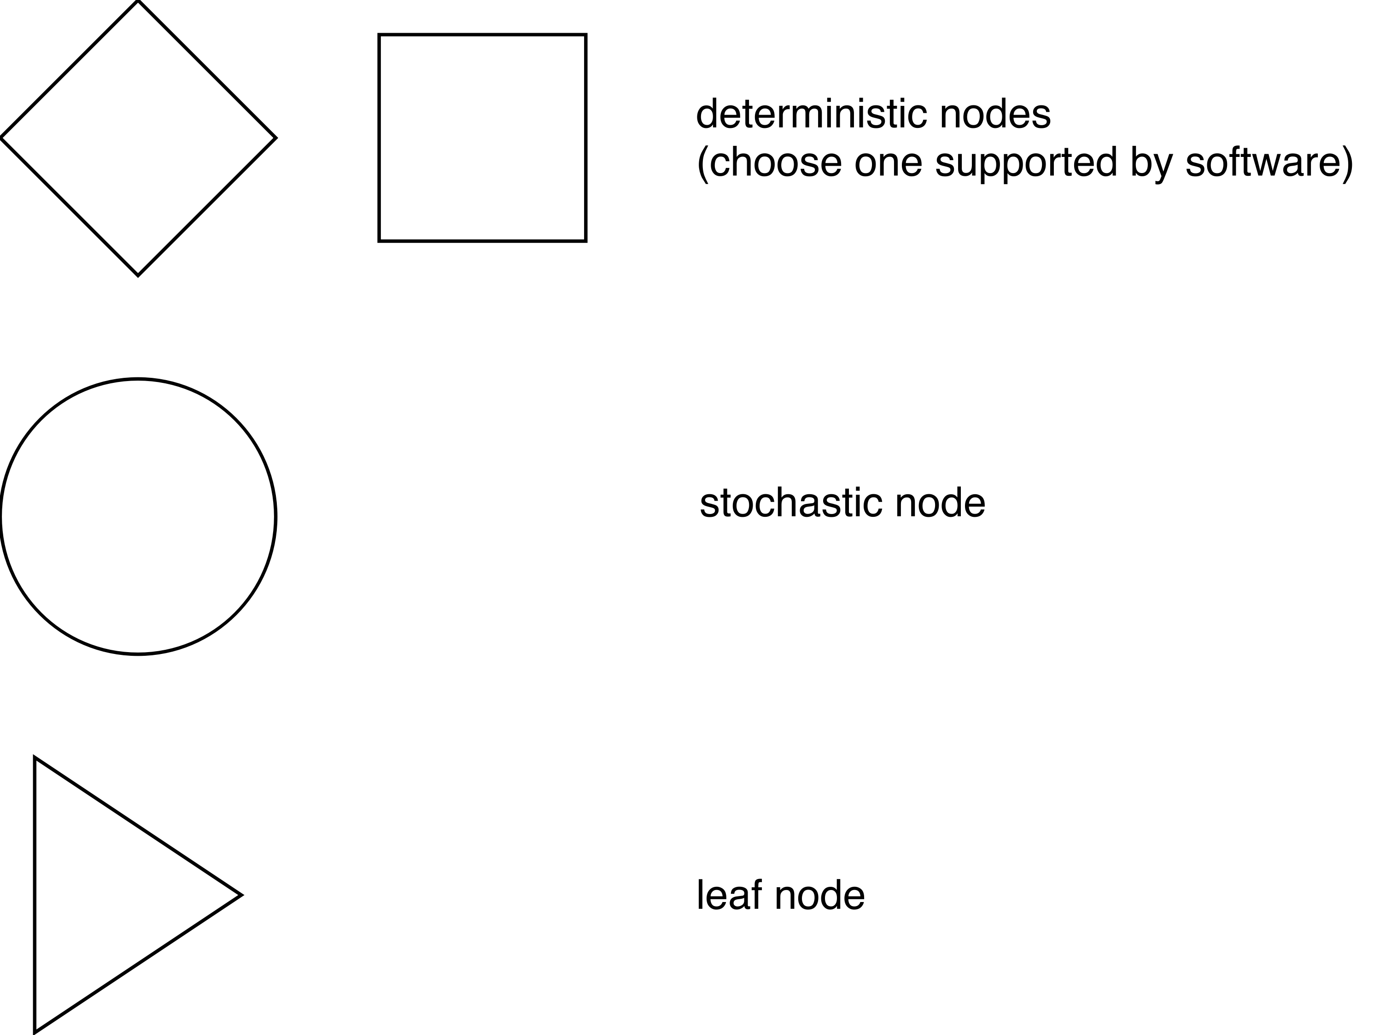
Constructors of decision tree
Deterministic tree uses only deterministic and leaf nodes
Stochastic tree has at least one stochastic node
Most trees are stochastic
But no tree is fully stochastic

Slide 16
Decision trees
Deterministic tree
Stochastic tree
Deterministic node
Stochastic node
root
Leaf node

Slide 17
Decision trees - notes
Nodes can be numbered – use it to separate tree structure and utility computations
Deterministic tree – just compute the utility from root to every leaf and choose what is best
Stochastic trees
compute utility from root to leaf and
Apply probabilities backward
Stochastic node utility is computed as
Best option available only as the tree is computed back to its root
Now choose the optimal variant (considering probabilities)
$$\sum_{i=1}^{n}{p_{i}U_{i}}$$
Where:
pi … probability of branch I
Ui … utility of branch i

Slide 18
Deterministic decision tree example
Company XYZ must decide whether to or not to reconstruct its business premises. At present time the company is capable to sell its products for 2,5 mil. EUR, during reconstruction the company would have to temporally move into alternative buildings, from which only 1 mil. EUR worth of its products could be sold. The reconstruction is expected to take one year and will cost 10 mil. EUR. In new business premises the company hopes to sell its products worth 3 mil. EUR per year. Recommend whether to or not to reconstruct, considering 10 years time horizon.

Slide 19
Evaluation of decision tree
Node 2: no reconstruction
Profit:
2,5 mil EUR * 10 = 25 mil. EUR
Node 4: we reconstructed Income: 1. year: 1 mil. EUR Post rec.: 3 * 9 mil. EUR = 27 mil. EUR sum: 28 mil. EUR
Costs: Reconstruction: 10 mil. EUR Profit: 28 – 10 = 18 mil. EUR

Slide 20
Stochastic decision tree - example
Government committee considers economical usefulness of preventive influenza vaccination program. For such program the committee considers “early warning” system, which will cost 120 mil EUR and will permit to detect early start of influenza epidemic. After the early warning, the vaccination program will start. If the vaccination program will not be realized, we estimate the cost of medication 280 mil. EUR with probability of 0,1, 400 mil EUR with probability of 0,3 and 600 mil. EUR with probability of 0,6. The vaccination program will cost 400 mil EUR and probability of influenza coming is 0,75. We consider the vaccine to function immediately and be 100% effective.

Slide 21
Tree structure

Slide 22
Computation and evaluation of the tree
Cost
Not vaccinating and no epidemic: 0EUR (1-2-5)
Not vaccination and epidemic with low costs: -280EUR (1-2-3-6)
Not vaccination and epidemic with middle costs: -400EUR (1-2-3-7)
Not vaccination and epidemic with high costs: -600EUR (1-2-3-8)
Early warning system and no epidemic: -120EUR (1-4-9)
Early warning system and epidemic: -520EUR (1-4-9)

Slide 23
Using probabilities
Cost node 3: (-280 * 0,1) + (-400 * 0,3) + (- 600 * 0,6) = -508 mil. EUR
Cost node 2: 0 * 0,25 + (-508 * 0,75) = -381 mil. EUR
Cost node 4: (-120 * 0,25) + (-520 * 0,75) = -420 mil. EUR

