Slide 1
Project management and CPM method
Modelling of Decision Processes
Doc. Ing. Pavel Šenovský, Ph.D.

Slide 2
Project
Sequence of activities
Beginning and end defined
Limited resources
financial
human
other (material, required machinery, ...)
Management of the project – the effort to control the project so it can be finished in time with the planed resources

Slide 3
Critical path method (CPM)
CPM = Critical Path Method
Developed by Morgan R. Walker and James E. Kelly, jr. in fifties of 20th century
CPM as a term used up to date, the original way to calculate it does not
CPM in modern sense is used to analyze project networks

Slide 4
Inputs
Original CPM
List of activities
Time definition of the activities (how long it takes to finish them)
Links between the activities
Modern approach
Based on original CPM and
List of resources
Resources characteristics
Usage of resources by activities
Quantification of the resource needs by activities

Slide 5
Activities – predecessors and followers
Predecessors – activities which must be finished just before the inspected activity can start
Followers – activities which must start after the inspected activity is finished
Both approaches describe links between the project activities
Both approaches are commutable (lead to same results – same project structure)
If using software – it is possible to translate between them automatically

Slide 6
Activities – predecessors vs followers
 | activity | followers | Prede-cessors | length [days]
A | excavation of foundations | B | - | 2
B | concreting the foundations | C | A | 10
C | gross building | D | B | 17
D | Roof | E,F,G,H | C | 5
E | Electro installation | I | D | 5
F | Pipelines (water, gas) | I | D | 5
G | Heating | I | D | 5
H | Windows | I | D | 14
I | Plaster, floors | J | E,F,G,H | 21
J | Final inspection | - | I | 1

Slide 7
Project network development

Slide 8
Network
Activities in diagram are links (not nodes!)
Networks is relatively compact – it shows linkage between activities (and possibly its basic properties)
Whole project is on relatively small space
Clear identification of the critical path
Using software
Start and end date of the activity
Length (of activity)

Slide 9
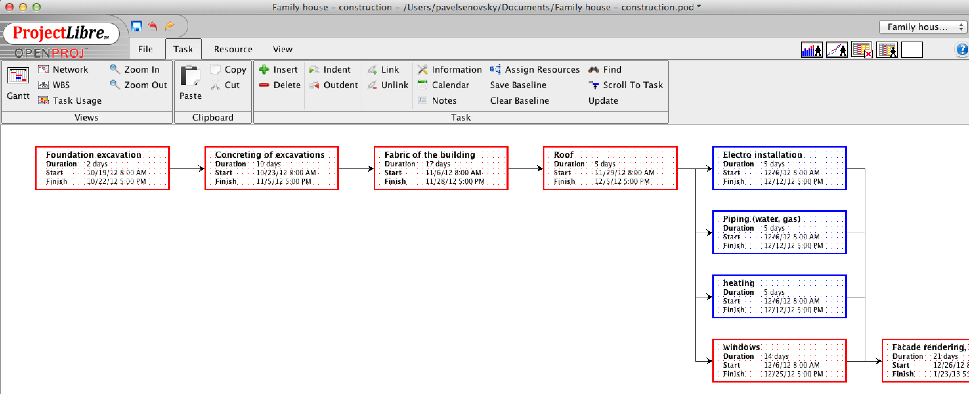
Software support
Project Libre – open source project management software
Made in Java (able to run almost anywhere)
1.7.0 version available on my homepage (http://homel.vsb.cz/~sen76/)
Basic functionality comparable to MS Project
MS Project – de facto standard in the field of project management

Slide 10
Critical path
Start to finish path in the project
There is always critical path
Properties of critical path
Longest path in diagram between start and finish of the project
Increasing length of any activity on such path automatically leads to increasing time of the whole project
Management of „critical“ activities is premise to effective management of the project

Slide 11
Network diagram - disadvantages
The length (time perspective) of the activities and project is not easily identifiable
Does not support easy manipulation with activities (does not support work of manager)
The need to have different perspective on activities – which would not have these disadvantages
HARMONOGRAM
GANT’s DIAGRAM

Slide 12
Harmonogram
Again diagram
Not a network graph
Activities list Y-scale
X-scale is dedicated to time
Preserves linkage between the activities (the links are visible in graph)
Also capable to visualize the critical path

Slide 13
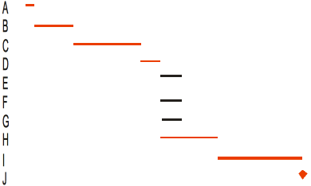
Harmonogram by hand

Slide 14
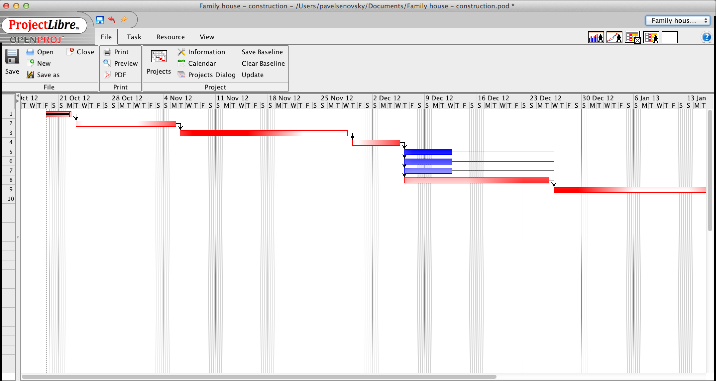
Gant’s diagram – SW support

Slide 15
Critical activities II
What is the difference between the critical and non-critical activity?
Time (other resource) reserve
There are no reserves on critical path!
We have reserves in non-critical activites,
manager can free these reserves and use them to support critical activities which are running out of control
What can we do?
It is possible to move in time non-critical activity or spread it in time
The goal is to free resources connected to the non-critical activity

Slide 16
Other features of Gant’s diagram
Manipulation with activities using mouse (drag and drop support)
Moving the activity
Changing the length of it
Monitoring compliance with plan
Possible to sign % of finishing of the activity
Continuous control over the project (where are we completion wise)
Early identification of problem – so we can still effectively solve it

Slide 17
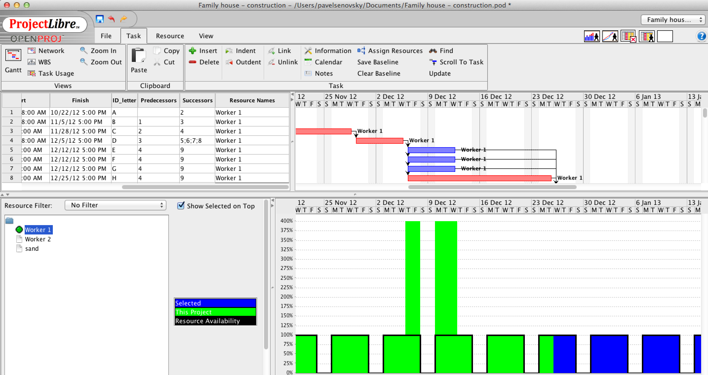
Other perspectives of the project – overusing the
resources

Slide 18
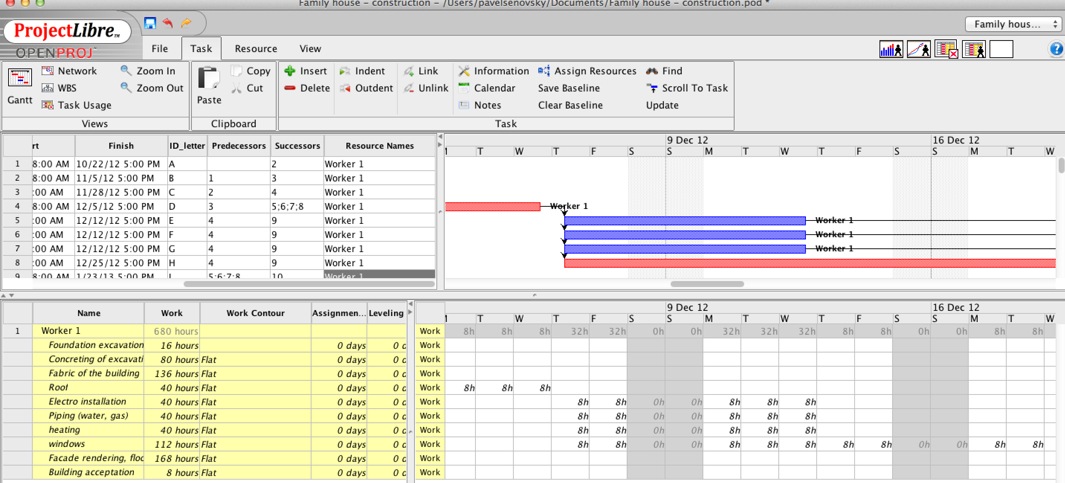
Other perspectives of the project – overusing the
resources

Slide 19
SW support
Available lot of commercial and open source tools for project management support
MS Project is considered as standard for it
Desktop version (available in faculty’s computer laboratory)
Server version available
Project Libre - http://www.projectlibre.org/
Open source
Multiplatform
Reasonably compatible

