Slide 1
AHP (Analytic Hierarchy process)
Modelling of Decision Processess
doc. Ing. Pavel Šenovský, Ph.D.

Slide 2
Multi-criteria analysis
In the lectures we already discussed the problem in terms of „distance“ of the solution variant to optimum
Minimalizing the distance for utility
Maximizing the distance to riskiest variant
There were multiple limitations to the methods
Criteria must be (ideally) independent
Interpretation of the connections between the criteria is not considered by MCA
Weights derivation is usually not that precise (using pairwise comparison)

Slide 3
AHP (Analytic Hierarchy Process)
Developed in 1970s by Thomas L. Saaty
Used for
Complex decisions – with multiple criteria
Group decision making
Today most widely used method for MCA
Its parts are also usable to solve partial problem – i. e. derivation of weight coefficients – with a way to measure its consistency
Multiple software packages exist to help with computation
More general form exists – ANP (Analytic Network Process), also developer by Saaty

Slide 4
AHP procedure
Model problem as a hierarchy – decompose the problem into form of hierarchy
Evaluate hierarchy – pairwise comparison from point of wiev of importance to the problem solution
Compute priorities (establish weight system)

Slide 5
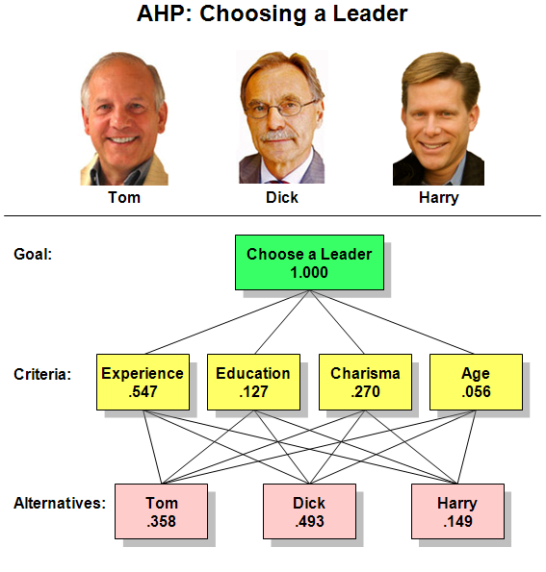
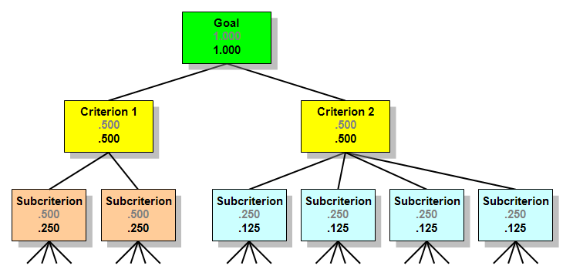
Hierarchy
Can be as complex as needed
Depends on what you actually need to do
Choose between known variant?
Derive general evaluation system?

Slide 6
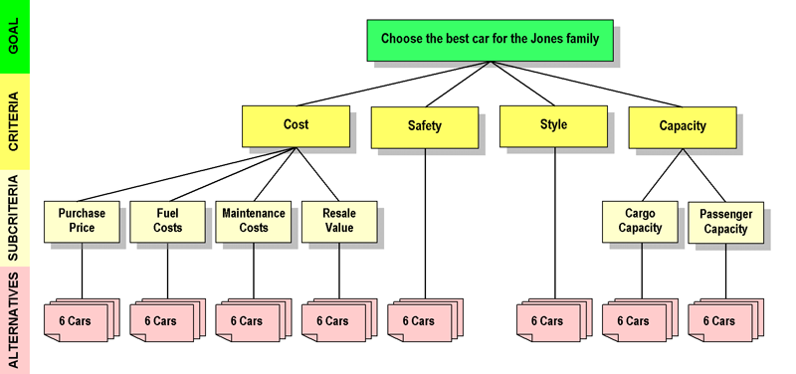
Create the hierarchy

Slide 7
Pairwise comparison
Scale 1 – 9
1 – equally important
3 – moderate importance
5 – strong importance
7 – very strong importance
9 – extreme importance
Even numbers can be used for finer distinguishing between the criteria
Possible to use 1.1, 1.2, … for even finer distinguishing
(not binary pairwise comparison)
The comparison is performed for each part of the chierarchy

Slide 8
Pairwise comparison – 3 groups in our case
1
2
3
4-11
Every leaf node will have it‘s own group to compare – comparison will be between the alternatives

Slide 9
Group 1
Criteria |  | More important | Intensity
A | B
Cost | Safety | A | 3
Cost | Style | A | 7
Cost | Capacity | A | 3
Safety | Style | A | 9
Safety | Capacity | A | 1
Style | Capacity | B | 7
Group 1 – in matrix
 | Cost | Safety | Style | Capacity
Cost | 1 | 3 | 7 | 3
Safety | 1/3 | 1 | 9 | 1
Style | 1/7 | 1/9 | 1 | 1/7
Capacity | 1/3 | 1 | 7 | 1

Slide 10
Group 2
 | Purchase Price | Fuel Costs | Maintenance Costs | Resale Value
Purchase Price | 1 | 2 | 5 | 3
Fuel Costs | ½ | 1 | 2 | 2
Maintenance Costs | 1/5 | ½ | 1 | ½
Resale Value | 1/3 | ½ | 2 | 1
Group 3
 | Cargo capacity | Passenger capacity
Cargo capacity | 1 | 1/5
Passenger capacity | 5 | 1

Slide 11
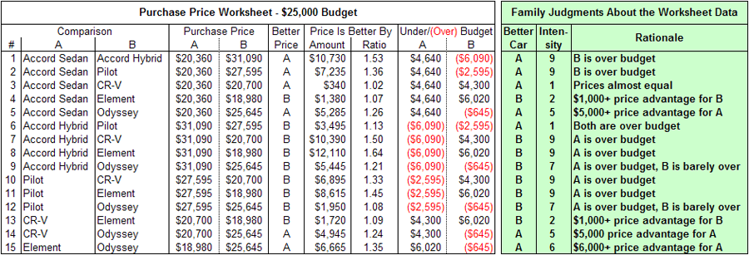
To effectively choose – variants must be compared (vs leaf nodes of the hierarchy)
Various approaches possible – use numeric function

Slide 12
Or derive preferences based on complex evaluation

Slide 13
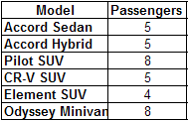
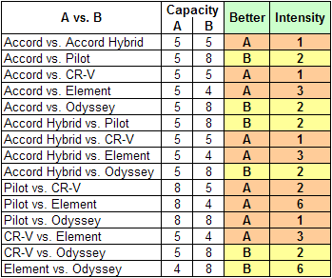
Create custom function for preference

Slide 14
Purchase price - matrix
 | Accord Sedan | Accord Hybrid | Pilot SUV | CR-V SUV | Element SUV | Odyssey Minivan
Accord Sedan | 1 | 9 | 9 | 1 | ½ | 5
Accord Hybrid |  | 1 | 1 | 1/9 | 1/9 | 1/7
Pilot SUV |  |  | 1 | 1/9 | 1/9 | 1/9
CR-V SUV |  |  |  | 1 | 5 | ½
Element SUV |  |  |  |  | 1 | 6
Odyssey Minivan |  |  |  |  |  | 1
Fuel costs - matrix
 | Accord Sedan | Accord Hybrid | Pilot SUV | CR-V SUV | Element SUV | Odyssey Minivan
Accord Sedan | 1 | 1/3 | 5 | 3 | 4 | 3
Accord Hybrid |  | 1 | 9 | 5 | 7 | 6
Pilot SUV |  |  | 1 | ¼ | 1/3 | ¼
CR-V SUV |  |  |  | 1 | 2 | 1
Element SUV |  |  |  |  | 1 | 1
Odyssey Minivan |  |  |  |  |  | 1

Slide 15
Maintenance costs - matrix
 | Accord Sedan | Accord Hybrid | Pilot SUV | CR-V SUV | Element SUV | Odyssey Minivan
Accord Sedan | 1 | 2 | 4 | 4 | 4 | 5
Accord Hybrid |  | 1 | 4 | 4 | 4 | 5
Pilot SUV |  |  | 1 | 1 | 2 | 1
CR-V SUV |  |  |  | 1 | 1 | 3
Element SUV |  |  |  |  | 1 | 2
Odyssey Minivan |  |  |  |  |  | 1
Resale value - matrix
 | Accord Sedan | Accord Hybrid | Pilot SUV | CR-V SUV | Element SUV | Odyssey Minivan
Accord Sedan | 1 | 3 | 4 | ½ | 2 | 2
Accord Hybrid |  | 1 | 2 | 1/5 | 1 | 1
Pilot SUV |  |  | 1 | 1 | 1/6 | ½
CR-V SUV |  |  |  | 1 | 4 | 4
Element SUV |  |  |  |  | 1 | 1
Odyssey Minivan |  |  |  |  |  | 1

Slide 16
Safety- matrix
 | Accord Sedan | Accord Hybrid | Pilot SUV | CR-V SUV | Element SUV | Odyssey Minivan
Accord Sedan | 1 | 1 | 5 | 7 | 9 | 1/3
Accord Hybrid |  | 1 | 5 | 7 | 9 | 1/3
Pilot SUV |  |  | 1 | 2 | 9 | 1/8
CR-V SUV |  |  |  | 1 | 2 | 1/8
Element SUV |  |  |  |  | 1 | 1/9
Odyssey Minivan |  |  |  |  |  | 1
Style - matrix
 | Accord Sedan | Accord Hybrid | Pilot SUV | CR-V SUV | Element SUV | Odyssey Minivan
Accord Sedan | 1 | 1 | 7 | 5 | 9 | 6
Accord Hybrid |  | 1 | 7 | 5 | 9 | 6
Pilot SUV |  |  | 1 | 1/6 | 3 | 1/3
CR-V SUV |  |  |  | 1 | 7 | 5
Element SUV |  |  |  |  | 1 | 1/5
Odyssey Minivan |  |  |  |  |  | 1

Slide 17
Cargo Capacity - matrix
 | Accord Sedan | Accord Hybrid | Pilot SUV | CR-V SUV | Element SUV | Odyssey Minivan
Accord Sedan | 1 | 1 | ½ | ½ | ½ | 1/3
Accord Hybrid |  | 1 | ½ | ½ | ½ | 1/3
Pilot SUV |  |  | 1 | 1 | 1 | 1/2
CR-V SUV |  |  |  | 1 | 1 | ½
Element SUV |  |  |  |  | 1 | 1/2
Odyssey Minivan |  |  |  |  |  | 1
Passenger Capacity - matrix
 | Accord Sedan | Accord Hybrid | Pilot SUV | CR-V SUV | Element SUV | Odyssey Minivan
Accord Sedan | 1 | 1 | ½ | 1 | 3 | 1/2
Accord Hybrid |  | 1 | ½ | 1 | 3 | 1/2
Pilot SUV |  |  | 1 | 2 | 6 | 1
CR-V SUV |  |  |  | 1 | 3 | ½
Element SUV |  |  |  |  | 1 | 1/6
Odyssey Minivan |  |  |  |  |  | 1

Slide 18
Weight derivation
$$P=\left|\begin{matrix}1 & p_{1…} & p_{1n} \\ \frac{1}{p_{1…}} & 1 & p_{…n} \\ \frac{1}{p_{1n}} & \frac{1}{p_{…n}} & 1\end{matrix}\right|$$
We established preference matrix
We presume, that the preferences do correspond to true weights ratio of the criteria
We can express that as optimalization problem
(k is number of evaluated criterions)
Leads to problem of quadratic programming – which is actualy computationally expensive (and very hard to solve pen & paper)
$$F=\sum_{i=1}^{k}{\sum_{j=1}^{k}{{\left(p_{ij}−\frac{w_{i}}{w_{j}}\right)}^{2}}}→min$$

Slide 19
Computing by approximation to geometric mean
Only approximation – for complex problems such approximation may be not precise enough
Evaluate consistency by computing consistency index
We can compare the result against random consistency index to compure consistency ratio
$$w_{i}=\frac{{\left(\prod_{j=1}^{k}{p_{ij}}\right)}^{\frac{1}{k}}}{\sum_{i=1}^{k}{{\left(\prod_{j=1}^{k}{p_{ij}}\right)}^{\frac{1}{k}}}}$$
$$CI=\frac{w_{max}−k}{k−1}$$

Slide 20
Consistency ratio
$$CR=\frac{CI}{RCI_{k}}$$
Random Consistency index
Good value is CR < 0,1
Such CR is usually considered good enough to reject null hypothesis that our computed weights are random
k | 1 | 2 | 3 | 4 | 5 | 6 | 7 | 8 | 9 | 10
RCI | 0 | 0 | 0,58 | 0,9 | 1,12 | 1,24 | 1,32 | 1,41 | 1,45 | 1,49

Slide 21
AHP using R
„ahp“ package available
It supports decision making
Does not support establishing weights for hierarchy only
Usage:
library(ahp)
cars <- Load("c:/path/cars.ahp")
Calculate(cars)
library(data.tree)
print(cars, filterFun = isNotLeaf)
Analyze(cars)
AnalyzeTable(cars)

Slide 22
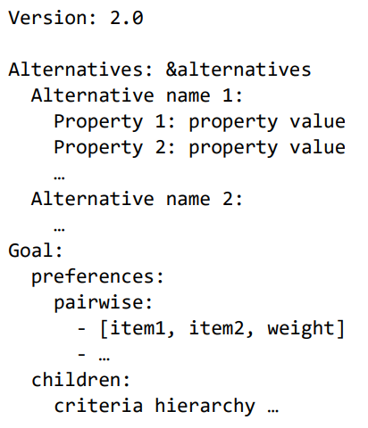
Input file format
YAML – YAML Ain‘t Markup Language
Relatively painful to create by hand
Structure:
The Car example has input file with over 250 lines of code to describe the problem

Slide 23
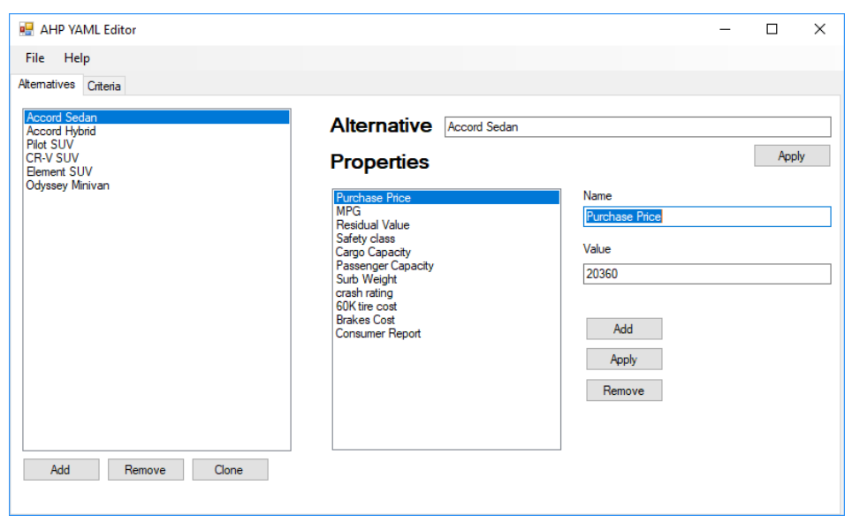
GUI for YAML file creation
https://fbiweb.vsb.cz/~sen76/data/uploads/programy/AHPEditor%20v0.1.7z
Requires .NET framework
Open source (MIT licence)
At present time functional under Windows only

Slide 24
Hierarchy creation using GUI

Slide 25
Notes
Clicking leaf node check box will allow to directly compare alternatives
„ahp“ package allows for usage of functions to derive weights
The GUI does not support this feature
But is usable to define basic hierarchy and the rest is doable in text editor

Slide 26
Print function – prints hierarchy
levelName
1 Root
2 ¦--Cost
3 ¦ ¦--Purchase Price
4 ¦ ¦--Fuel Costs
5 ¦ ¦--Maintenance Costs
6 ¦ °--Resale Value
7 ¦--Safety
8 ¦--Style
9 °--Capacity
10 ¦--Cargo Capacity
11 °--Passenger Capacity

Slide 27
Analysis results

